Slide 1




The Introduction of substitutional and non-substitutional dopants into MgB₂ in high pressure/Temperature or non-equilibrium regimes
The Ohio State University
M.D. Sumption
M.A. Susner
Y. Yang
& E.W. Collings

Slide 2
Motivation and Outline
Substitution of C for B is well documented in MgB₂
We are interested to generate site substitutions of Zr or Ti for Mg in MgB₂, to change B_{c2}, or to generate heterostructures/secondary phases, to induce flux pinning
We have made high quality MgB₂ thin films by Pulsed Laser Deposition (PLD), and have used these non-equilibrium conditions to attempt to incorporate Zr and Ti
We have also used high temperature/high pressure to melt MgB₂ with Zr and Ti additions through the peritectic
Goal: To add Zr or Ti either as substitutions, or Zr- Ti-borides as fine secondary phases

Slide 3
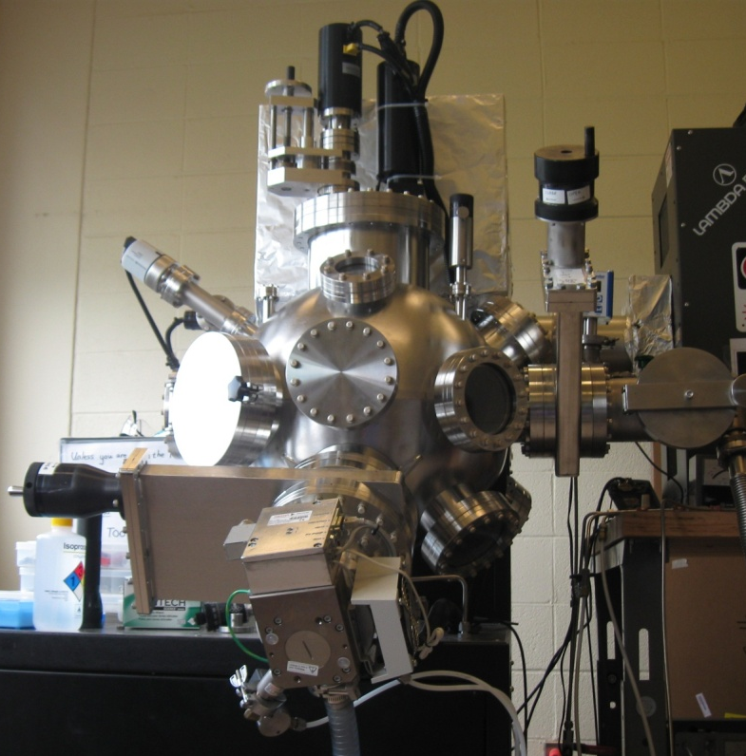
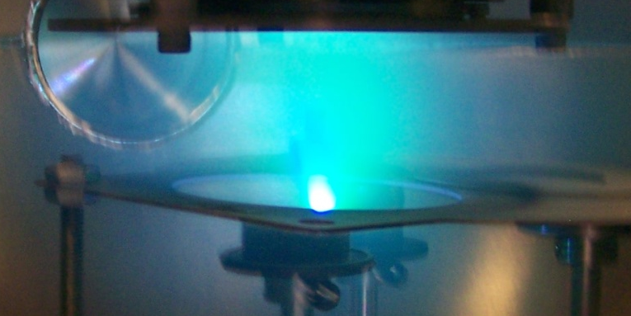
MgB₂ thin films
KrF excimer laser,
λ=248 nm
Focusing lens
Resistive heater (1050ºC max.)
SiC (0001) substrate
MgB₂ target mounted on rotating platform
SiC (0001) substrate
to turbo
Nom. 25 ns laser pulse, λ=248 nm
400 mJ max. energy (typically ~4 J/cm² energy density) impinges upon the MgB₂ target, producing significant, rapid heating of target material
A laser-induced plasma forms on the target surface
Plasma forwardly and supersoniacally ejected from interaction volume, forms “plume”
Plume impinges upon the substrate, depositing plume species on surface

Slide 4
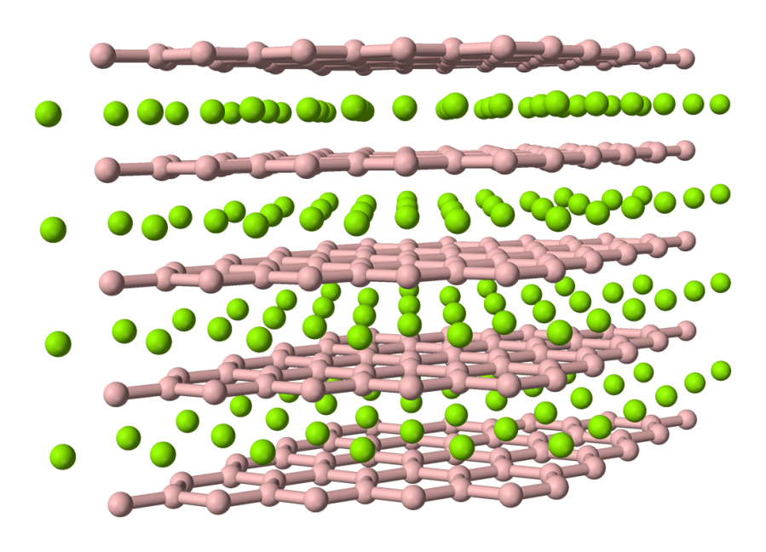
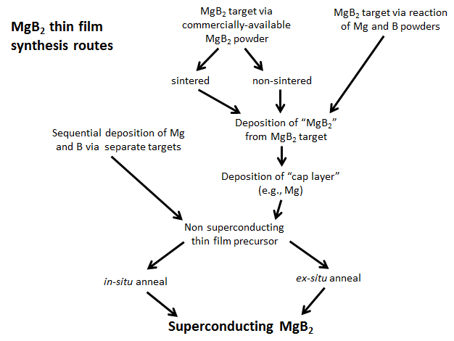
PLD synthesis routes
PLD synthesis routes for MgB₂

Slide 5
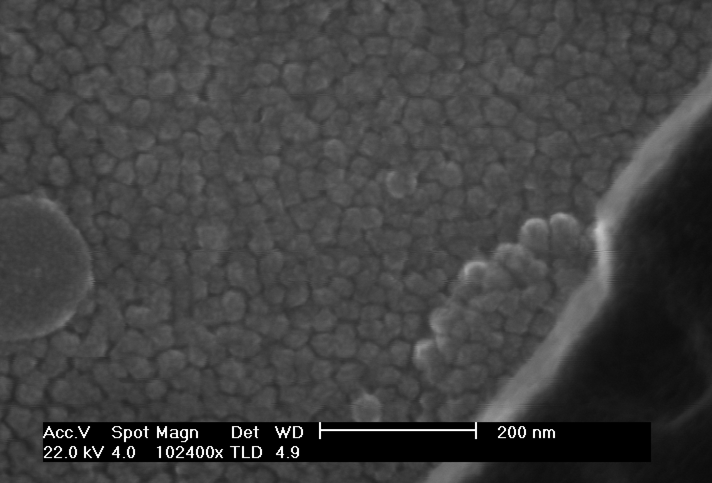
Growth of Undoped MgB₂ thin films
We have created granular MgB₂ thin films with a three-step process: (1) deposition of MgB₂, (2) deposition of Mg cap layer, and (3) anneal at ~700ºC at 1 atm highly purified Ar
Process optimized to drive up T_{c} to maximum seen in PLD-synthesized MgB₂ films

Slide 6
Glancing X-ray analysis of MgB₂ thin films
MgB₂ thin films are deposited on SiC substrates. They are c-axis oriented and are randomly oriented in-plane

Slide 7
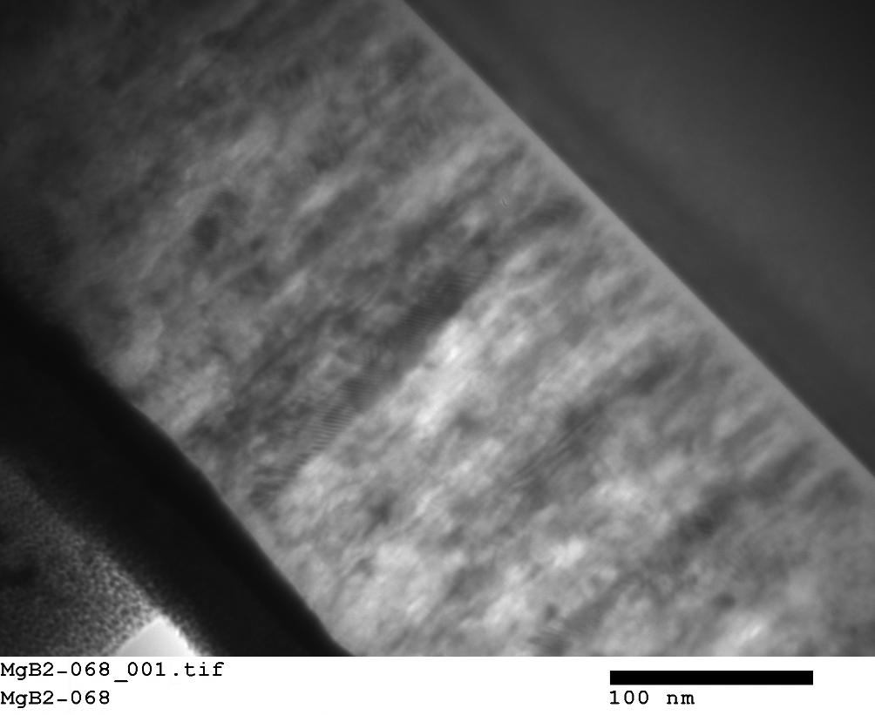
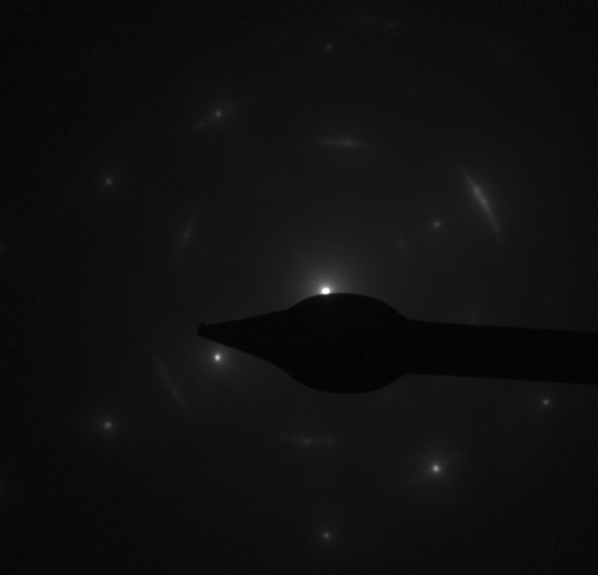
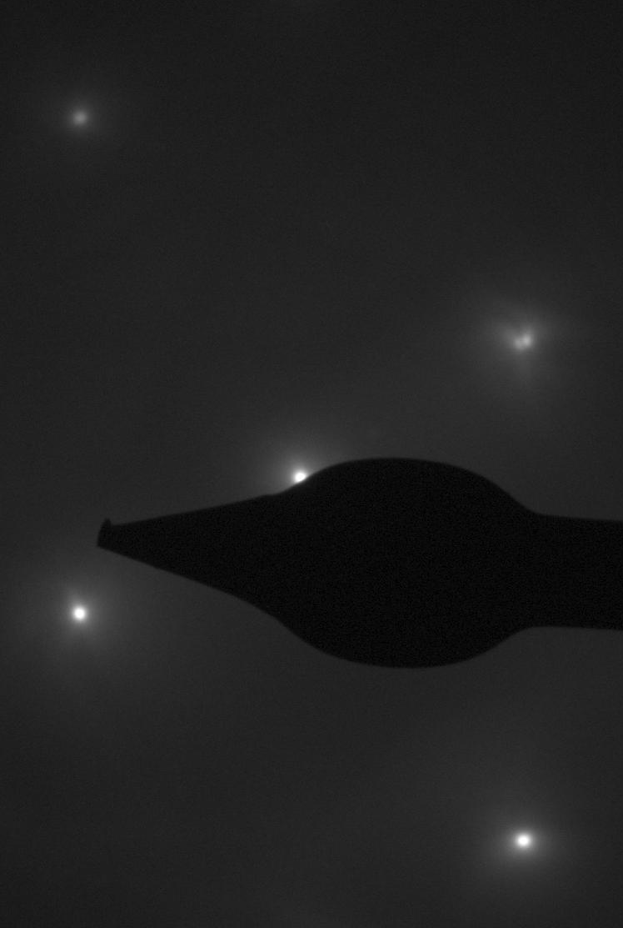
TEM of Undoped MgB₂
SiC
MgB₂ thin films are ~200 nm thick with an interface layer of Mg₂Si formed by reaction with the SiC substrate
MgB₂
200 nm
Pt

Slide 8
Addition of ZrB₂ by Superstructure formation + annealing
 | ZrB₂/MgB₂ | Nominal %ZrB₂ | T_{c,onset}, K (magnetic)
MgB₂-164 | 0/200 | 0 | 30.4
MgB₂-165 | 5/200 | 2.4 | 25.3
MgB₂-166 | 10/200 | 4.8 | 22.5
MgB₂-167 | 20/200 | 9.1 | 18.1
MgB₂-168 | 30/200 | 13.0 | 15.0
MgB₂-169 | 50/200 | 20.0 | 9.99
MgB₂-172 | 70/200 | 25.9 | 5.88
In pulses, ~ 33 pulses per MgB₂ layer X 100 repeats.
Zr additions were successfully introduced, but lower B_{c2}

Slide 9
STEM-EDS of MgB₂/ZrB₂ thin films

Slide 10
GID out of plane and in-plane diffraction
Peak shift seen in a-lattice parameter peaks

Slide 11
Lattice parameter shifts
a-lattice parameter increases with amount of ZrB₂ added
c parameter more or less constant
First clear demonstration of Zr substitution into MgB₂ lattice! -- but lowers properties

Slide 12
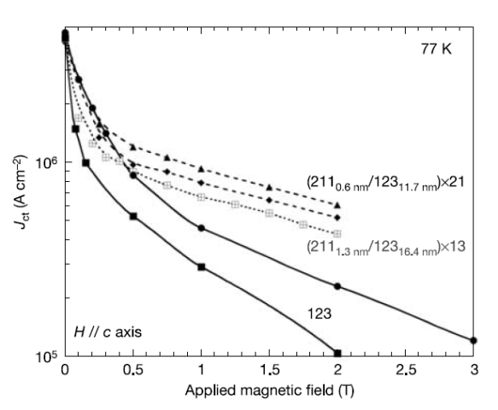
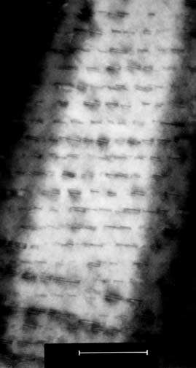
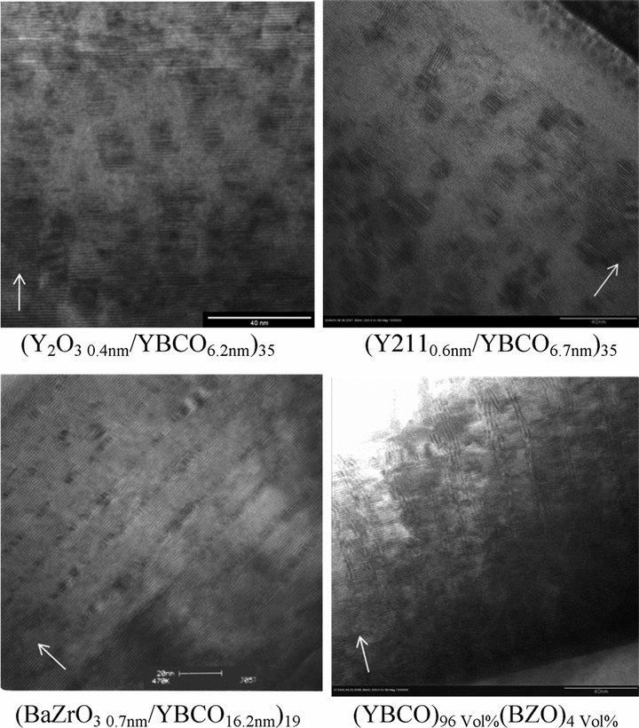
Heterostructures and flux pinning in high-T Superconductors
High T_{c} superconductors like YBa₂Cu₃O₇ need nano-scale defects to enhance the pinning of fluxons for high J, high B applications
Anything in which the YBCO lattice is disturbed over a 0.1-1 nm scale has been suggested (e.g. precipitates, dislocations)
The most successful experiments involve the formation of heterostructures:
Layered and 3D random nano dispersions that create stress fields
Self assembled nano-columns
35 layer YBa₂Cu₃O₇/ Y₂BaCuO5 nano-dispersion array
Various additives induce the formation of different heterostructure morphologies
T.Haugan, P.N. Barnes, R. Wheeler, F. Meisenkothen, and M.D. Sumption, Nature 430, 867-870 (2004)
50 nm
T.Haugan, F.Baca, M. Mullins, N.Pierce, T. Campbell, E. Brewster, P. Barnes, H. Wang, and M.D. Sumption, IEEE Trans. Appl. Supercond. 19(3), 2270-2274 (2009)

Slide 13
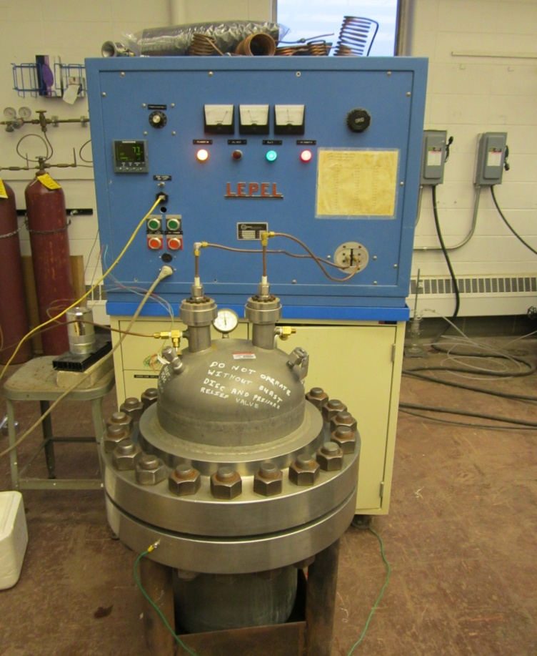
Possible Additions for MgB₂ heterostructure synthesis
 | Space group | a (Å) | c (Å) | Δa, %
Ti | P6₃/mmc | 2.951 | 4.684 | -4.38
AlB₂ | P6/mmm | 3.009 | 3.262 | -2.46
TiB₂ | P6/mmm | 3.038 | 3.239 | -1.52
MgB₂ | P6/mmm | 3.085 | 3.523 | --
NbB₂ | P6/mmm | 3.111 | 3.266 | 0.84
UB₂ | P6/mmm | 3.130 | 3.988 | 1.46
ZrB₂ | P6/mmm | 3.169 | 3.531 | 2.72
Zr | P6₃/mmc | 3.230 | 5.145 | 4.70
CdS | P6₃mc | 4.142 | 6.724 | 34.3
Ag (along (111) plane) | Fm-3m | 4.142 | 6.724 | 64.86
Possibility of impurity dispersion
Large amount of materials available in which to play with the effect of strain on the resulting microstructures-
Possibility of complex heterostructure formation
Difficult to find materials that are chemically compatible with MgB₂
Some targets are already made or purchased (Ti, TiB₂, MgB₂, ZrB₂); others will be synthesized via high-pressure, high T apparatus
2400ºC T_{max} at ambient Pressure,
1700ºC at 10 MPa (1500 psi)

Slide 14
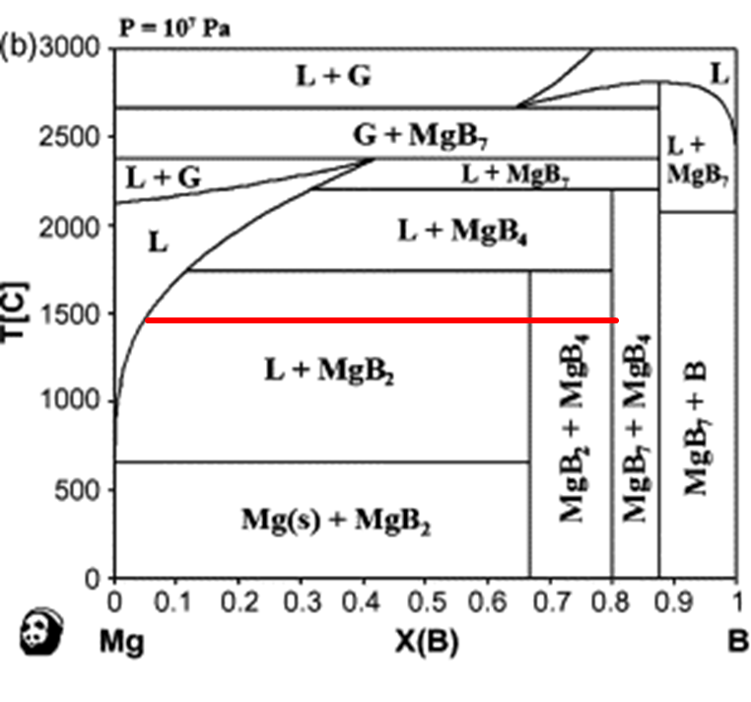
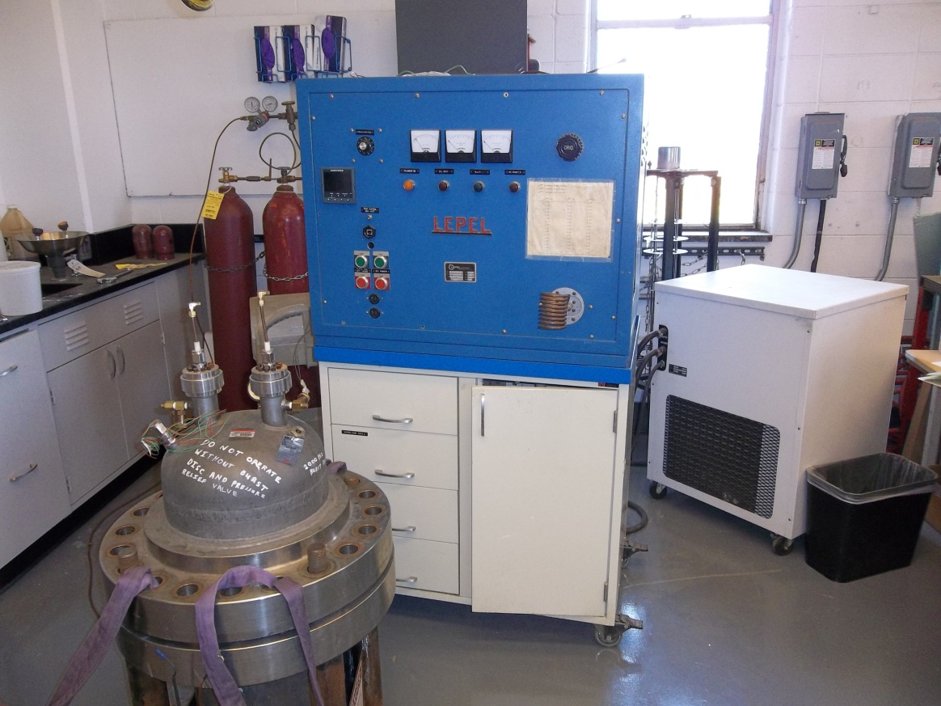
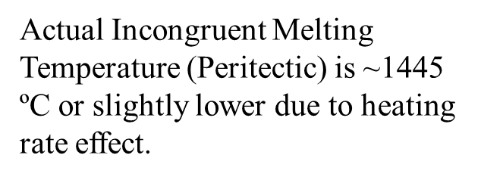
The high pressure furnace
High pressure vessel:
P_{max} is 10 MPa (~1500 psi).
T_{max} is about 2000ºC
T_{work} is up to 1700ºC

Slide 15
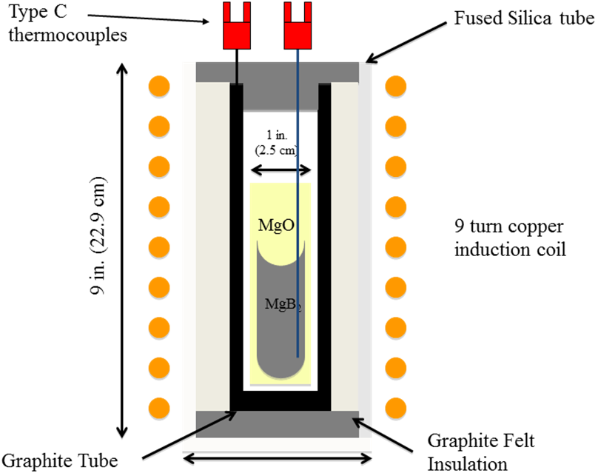
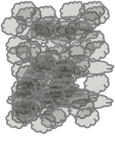

The high pressure furnace

Slide 16
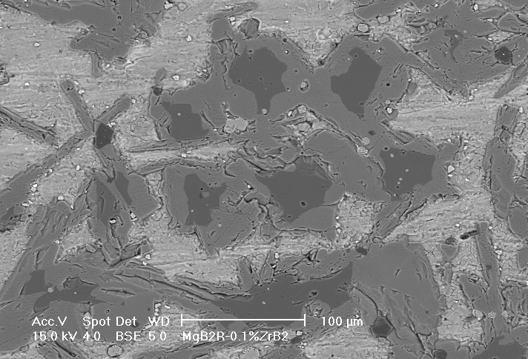
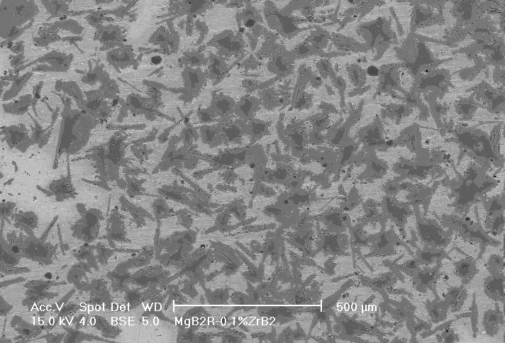
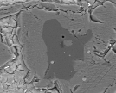
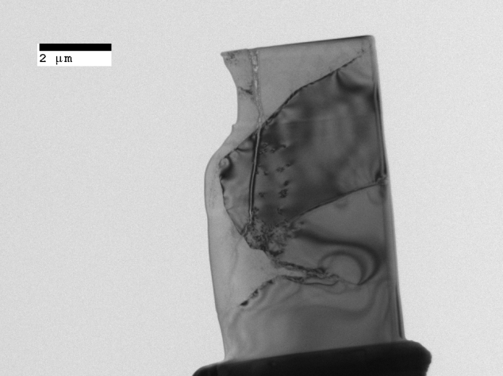
SEM images for 1at% ZrB₂ added bulk
MgB₂
ZrB2 added samples:
MgB₄
Mg
 | Mg | B | ZrB2 | Mg:B:ZrB2 | HT type
ZRB1% | 54.14% | 45.58% | 0.28% | 2.4:2:0.01 | HT2
ZRB5% | 33.85% | 61.54% | 4.61% | 1.1:2:0.15 | HT1
ZRB10% | 38.96% | 51.95% | 9.10% | 1.5:2:0.35 | HT2
ZrB₂?
MgB₇?
FIBbed senction

Slide 17
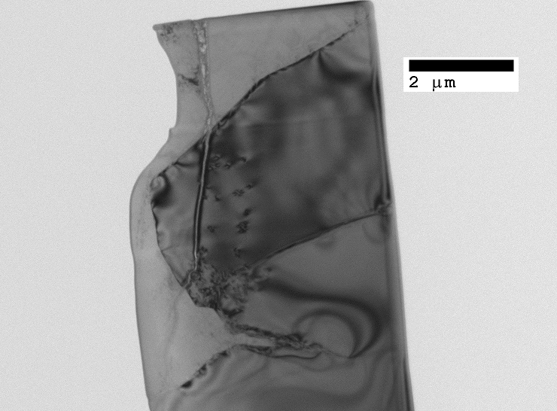
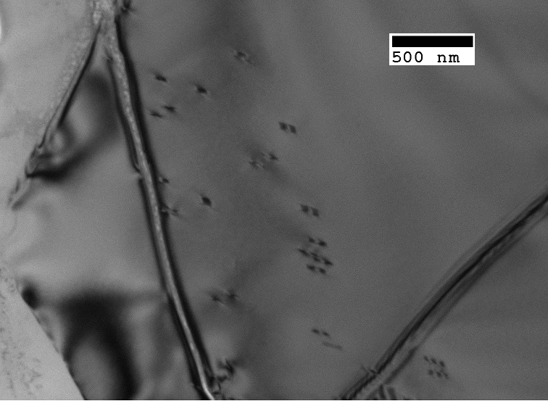
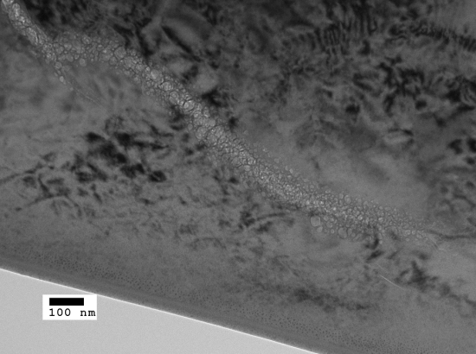
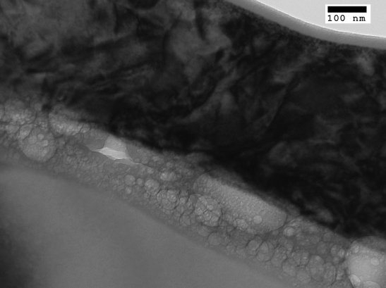
TEM images for 1at% ZrB₂ added bulk
FEI Helios 600 Advanced Dual-Beam SEM was used for TEM sample preparation.
~10μm in length and ~5 μ m wide slat
Bright field TEM images was obtained by Philips CM 200
<100nm

Slide 18
Magnetic results for 10at% ZrB₂ added bulk
M-T up to 6T and 50K
Double transition appeared
ZrB₂: T_{c}=5.5K
Inhomogeneity or substitution?
31.42K
22.58K

Slide 19
Summary
PLD thin film MgB2/ZrB2 heterostructures have been made.
Subsequently annealed, this has led to uniform Zr incorporation into the grains
The Zr is shifting the bulk lattice parameter, and also changes the Bc2 in a strong and uniform way with Zr level, suggesting Mg site substitution
STEM shows Zr uniformity within grains, Zr additions depress Bc2
High pressure induction furnace was used to push MgB2 through the peritectic, finding the correct peritectic temperature, about 1450 C.
Additions of ZrB2 led to Nano-sized particle/second phase(<100nm) widely distributed in the area close to the boundaries in 1at% ZrB₂ added MgB₂ ingot.
A double-transition behavior was observed in 10at% ZrB₂ added sample, suggesting soe Zr introduction into the MgB2
Further work will focus on other diboride additions with various levels of lattice match, to investigate nanophase pinning structures in PLD films, and possibly site substitution as well

Slide 20
ZrB₂ and TiB₂ added MgB₂ ingot
Zr and Ti were collected as potential candidates for the study of homogeneity doping and Mg site substitution.
Sample preparation:
Mg turning (-4mesh,99.98%, Alfar Aesar)
B powder(-325msh,99%, Alfar Aesar)
ZrB₂ powder(99.5%,,Alfar Aesar)
TiB₂ powder(99.5%, Alfar Aesar)
 | a, Å | c Å | c/a | space group | Atomic weight, g/mol
MgB₂ | 3.09 | 3.52 | 1.14 | P6/mmm | 45.93
ZrB₂ | 3.17 | 3.52 | 1.11 | P6/mmm | 112.85
TiB₂ | 3.03 | 3.23 | 1.07 | P6/mmm | 69.49
HT1:
Ramping: 500ºC to 1500ºC, 20ºC/min
Soaking: 1500ºC, 30min
Cooling: 1500ºC to 500ºC, 5ºC/min
HT2:
Ramping: 500ºC to 1700ºC, 20ºC/min
Soaking: 1700ºC, 20min
Cooling: 1700ºC to 500ºC, 5ºC/min
Ag Pressure: 10MPa

