Slide 1

Prospects of Nb₃Sn performance enhancement for high field fcc applications
Mike Sumption, X. Xu, and E.W. Collings
Center for Superconducting and Magnetic Materials, MSE, The Ohio State University
Hyper Tech Research, Inc.
Xuan Peng
Mike Tomsic
Selected data from
SupraMagnetics, Inc.
Leszek Motowidlo
This work was supported by the U.S. Department of Energy, Office of Science, Division of High Energy Physics, under SBIR phase I DE-SC0013849 and University Grant DE-SC0011721.

Slide 2
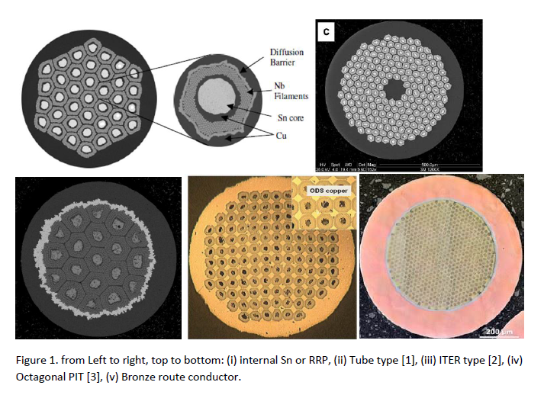
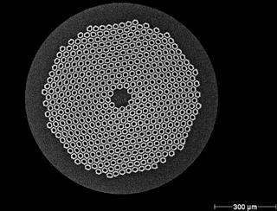
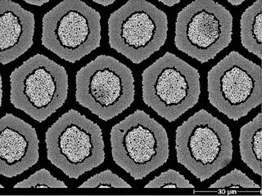
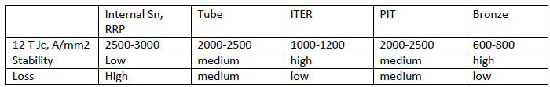
Nb₃Sn based Conductor Options
Bruker PIT Conductor
At 15 T J_{c} is 2700 A/mm², J_{nonCu} (RRP) = 1600 A/mm², and Tube/PIT 1350 A/mm²

Slide 3
Need of FCC for improved Nb₃Sn
Needed conductor amount for FCC
FCC with 16 T magnets: 4,500 tons of Nb₃Sn and 10,000 tons on NbTi
FCC with 20 T: 1,400 tons HTS, 6,300 tons Nb₃Sn, 11,000 tons NbTi
Conductor Specifications?
  Non Cu J_{c} of 1500 A/mm² at 16 T?
Will need both ternary alloy and enhanced pinning

Slide 4
Possibilities for Nb₃Sn J_{c} enhancement
Keep pinning the same but enhance Jc further from the presently optimized ternary (In principle maybe possible, but so far difficult)
Enhance pinning in Binary
Enhanced pinning in similar-to-present ternary alloy

Slide 5
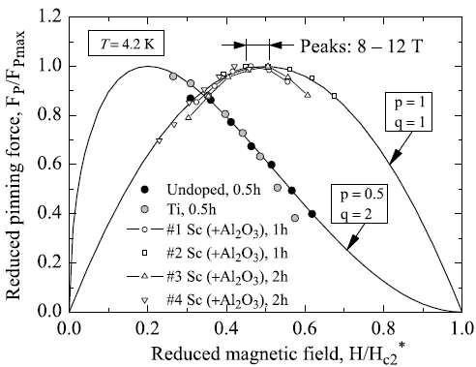
Importance of refining Nb₃Sn grain size
Maximum pinning force F_{p,max}
For present strands, reducing grain size leads to increase in F_{p,max}, but F_{p,max} is always at 0.2B_{c2}.
B_{c2}
0.2B_{c2}
Experiments (Dietderich, 1997) on films (electron-beam co-evaporation deposition): as grain size is very fine, the Fp-B curve peak shifts to 0.5B_{c2}.
The high-field J_{c} can be significantly improved by shifting F_{p,max} to 0.5B_{c2}.
50-100 nm
15-30 nm
How to obtain such small grain size in practical strands?
Reducing reaction temperature? Cannot go to < 80 nm.
Adding second phase particles to prevent grain coarsening?
D. R. Dietderich and A. Godeke, Cryogenics 48, 331 (2008).

Slide 6
Refine Nb₃Sn grain size by adding second phase particles
Methods | Effect | Problems
Add Y or Gd into Nb melt: form Y or Gd particles. | At 750 C, 0.75 % Y refines grain size from 400-500 nm to 200-300 nm. | Y or Gd particles harden Nb alloy, making processing impossible.
Procedures to fabricate Nb₃Sn:
Billet of Sn, Cu, Nb alloy
Extrusion, drawing
Final-size strand
The particles can only be formed during heat treatment.
Heat treatment
Superconducting Nb₃Sn
One method: internal oxidation.
A-B alloy
“Internal oxidation”: O diffuses in an A-B solid solution, and selectively oxidizes the solute B, forming BO_{n} particles in matrix A.
Prerequisites:
B is much less noble than A.
O diffuses fast in matrix A.
O partial pressure is only high enough to oxidize B.
J_{O}
O source
C
BO_{n}
C_{O}
C_{B}
Zone I
Zone II
For the case of Nb₃Sn, we can use Nb-Zr alloy, since Zr is much less noble than Nb.

Slide 7
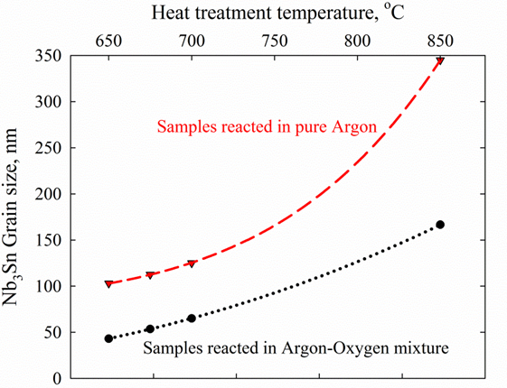
Can the internal oxidation method work for Nb₃Sn wires?
To find out if this internal oxidation method really works for Nb₃Sn strands, we made an experimental monofilament:
750 °C
Reacted in pure Ar
Cu stabilizer
First, etch off the outside Cu to expose Nb-1Zr to the atmosphere.
Nb
Newly-formed Nb₃Sn grains
Nb-1 at.%Zr
Earlier-formed Nb₃Sn grains
Cu
During heat treatment:
Pure Ar atmosphere: no oxygen supply
Ar-O mixture: sufficient O supply
Reacted in Ar-O
Sn core
X. Xu et al., Appl. Phys. lett. 104, 082602 (2014)
Note ZrO2 particles 10 nm OD
How do ZrO₂ particles refine Nb₃Sn grain size?
Impede Grains coarsening: distinct gradients in grain size.
Be nucleation centers: newly-formed grains in the internal oxidation samples are smaller.
Intra-granular ZrO₂ particles
Inter-granular ZrO₂ particles

Slide 8
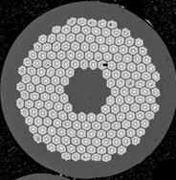
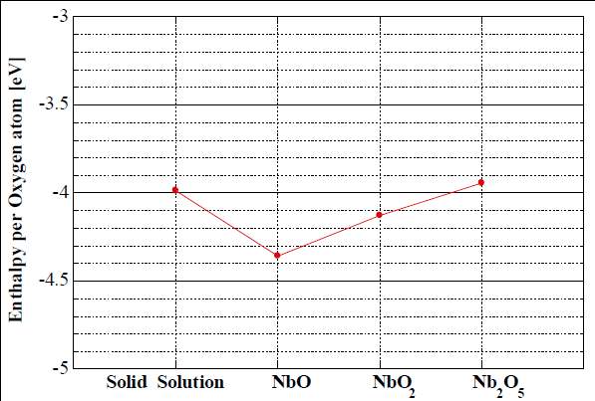
Supplying oxygen to Nb-Zr alloy in real strands
1. Supply O externally during heat treatment?
The diffusion of O in Cu layer: assuming C_{O}(O) = C_{s}, C_{O}(Nb) = 0.
In this work we will use oxide powder as O source, because powder possesses good flowability during wire processing.
The goal is to transfer the O from oxide powder to Nb1Zr during heat treatment.
O₂
O₂
O₂
Cu
O₂
r_{i}
Nb
r_{o}
O₂
O₂
O₂
O₂
Oxide and Nb-Zr do not have to contact. As long as the atmosphere is connected, O can be transferred via atmosphere.
T, 600 °C | O in Cu
D, μm²/s | 100
X_{s}, at.% | 10⁻⁵
Little O is absorbed by Nb-Zr.
Oxide powders that can supply O to Nb:
CuO, SnO₂, ZnO, Nb₂O₅.
Oxide powders that cannot supply O to Nb:
NbO or NbO₂.

Slide 9
An example tube type monofilament
A green-state subelement:
A control: NbO₂, which does not supply O.
SnO₂ powder: 625 °C:
Cu
Wires with NbO₂ and SnO₂: 650 C for 150 h:
NbO₂: < 0.3at.% O, SnO₂: supplied >3 at.% O.
Nb-1Zr
SnO₂
NbO₂
SnO₂
Cu
Sn core
200 nm
200 nm
Ave: 36 nm
SnO₂-650 °C / 400h:
Average grain sizes: 104 nm and 43 nm.
The 12 T layer J_{c} of the state-of-the-art Nb₃Sn strands is 5 kA/mm², so the SnO₂-625x800h doubles this record.
Hyper Tech- Ohio State application

Slide 10
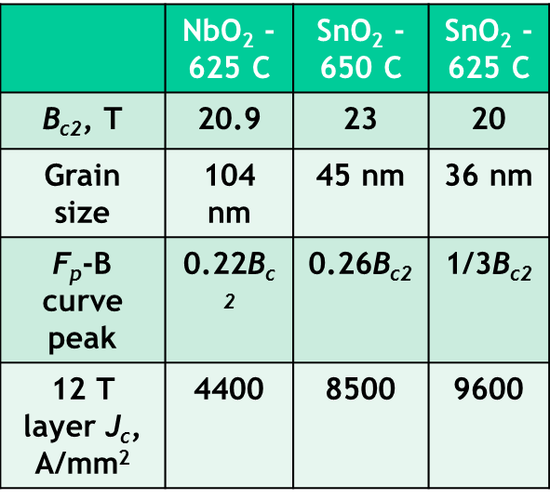
F_{p}-B curves of Internal oxidation strands
F_{p,max} vs reciprocal of grain size:
Normalized F_{p}-B curves:
B_{c2} was obtained by fitting the F_{p}-B curve using F_{p}=Kb^{p}(1-b)^{q}.
Two companies are using this technique to fabricate products.
With the same Nb₃Sn phase fraction
As grain size d is < 50 nm, reducing d shifts the curve both to the up and to the right.
0.25 mm

Slide 11



Suppose we can further refine grain size, what will be the J_{c}?
Nb-1Zr + SnO₂ at: | B_{c2}, T | Grain size | F_{p}-B curve peak | 12 T layer J_{c}, A/mm²
650 C | 23 | 45 nm | 0.26B_{c2} | 8500
625 C | 20 | 36 nm | 0.34B_{c2} | 9600
Using Nb-2%Zr, 25 nm of grain size is likely reachable.
A Nb-2%Zr sample reacted at 650 °C:
Suppose grain size is refined to 20-25 nm with B_{c2} kept at 25 T.
4$.2×$
6$.2×$
Average grain size: 34 nm.
1$4×$
With grain size of 25 nm and B_{c2} = 25 T, what’s the J_{c}?
Parameters | Present best | Internally oxidized
B_{c2} (4.2 K), T | 25 T | 25 T
Grain size, nm | 100 – 150 | 25 nm
F_{p}-B peak | 0.2 B_{c2} | 0.5B_{c2}
F_{p,max}, GN/m³ | ~90 GN/m³ | ~250 GN/m³
State-of-the-art RRP wires with 4.2 K, 12 T non-Cu Jc of 3000A/mm².

Slide 12
Observations and Plans
Factors we can control: chemistry/processing
Composition/Microstructure
Properties
Performance
1. Starting Nb/Sn/Cu ratio
Nb₃Sn phase fraction
High-field J_{c}
2. Precursor architecture
Additions: Ta/Ti
B_{c2}
3. Doping: Nb-Ta, Sn-Ti
Sn content
F_{p,max}
4. Heat treatment: temperature, time
Grain size
5. Other approaches: e.g., internal oxidation
Peak field
Observations:
I_{c} of Nb₃Sn strands can be improved by improving: Nb₃Sn fraction, B_{c2}, and F_{p,max}.
There is still some room for B_{c2} improvement by enhancing Sn at.%. A model has been developed on what determines Sn content of Nb₃Sn and how to control it.
There is huge room for J_{c} improvement via grain size refinement. An internal oxidation method is proposed, and has been proven very effective.

Slide 13
Some Questions we might ask
Q1: what Nb₃Sn strands can this method be used in?
Q2: is it feasible to make practical strands?
Q3: Does the high J_{c} only exist in a very thin layer?
Q4: Is the refined grain size at the expense of B_{irr}?
Q5: Can we shift the F_{p}-B curve peak to 0.5B_{irr}?
Q6: Does this Hinder Margin?
Q7: Can we realize this for a multifilamentary ternary?

Slide 14
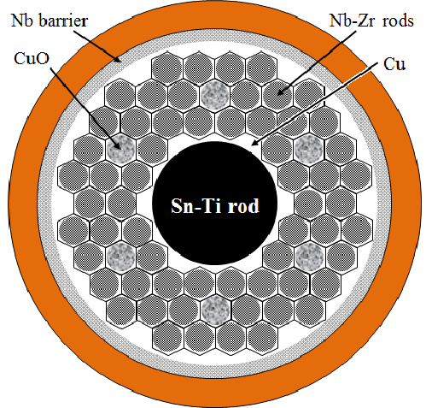
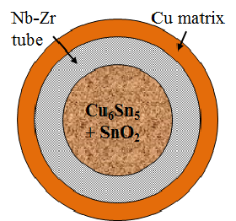
Q1: what Nb₃Sn strands can use this method?
Not Only Tube Conductor, but PIT, Bronze, or Internal Sn distributed barrier (e.g., RRP) –
As long as a structure allows for the addition of oxide powder in a proper position, so that oxygen can be transferred, this structure is OK.
PIT:
Patent: Xu, Peng, Sumption, PCT/US2015/016431.

Slide 15
Q2: the feasibility of making practical strands
We reported high J_{c} on a monofilament, but if this technique can not be used to make practical wires, then it is useless.
As to the application of this method, the biggest concern lies in the drawability of Nb-Zr alloy. But this appears not be a problem for strands up to 120 stack
Demonstration of making practical Tube and PIT strands:
Supramagnetics’ PIT (120-sub): d_{sub} ≈ 50 μm
Hyper Tech’s PIT (61-sub): d_{sub} ≈ 38 μm
0.4 mm
0.82 mm

Slide 16
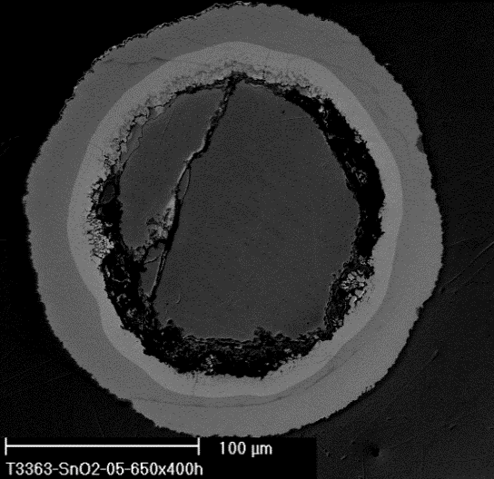
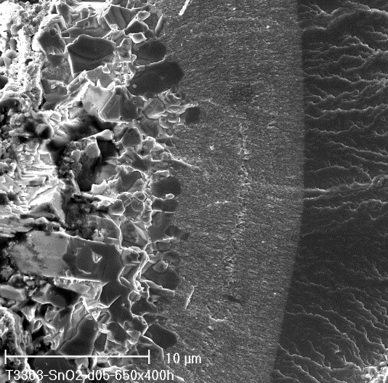
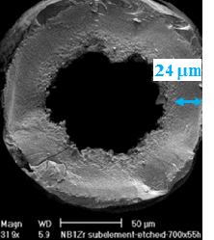
Q3: Does the high J_{c} only exist in a very thin layer?
650 C x 400h
8 μm
Fine grain size and associated high J_{c} can exist in a very thick Nb₃Sn layer:

Slide 17
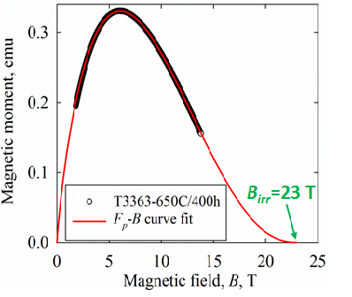
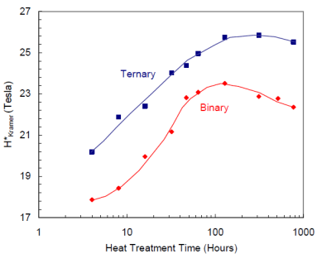
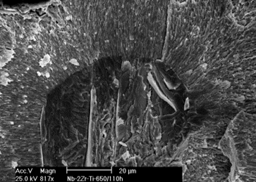
Q4: Is the refined grain size at the expense of B_{irr}?
Does refined grain size => reduced B_{c2}?
Fischer, Lee, Larbalestier, PIT, 675 °C:
4.2 K
Need ternary addition: Ta or Ti.
An ongoing experiment: Ti doping
Conclusion: introducing ZrO₂ particles and refining grain size do not decrease B_{irr} of Nb₃Sn strands relative to those ordinary strands. But we do need: 1, full reaction; 2, Ta or Ti addition.
With proper addition, we can push the B_{irr} to 25-26 T.

Slide 18

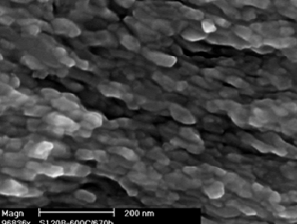
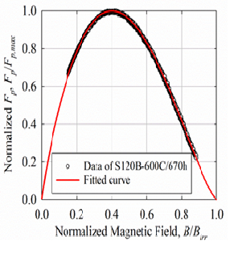
Q5: Can we shift the F_{p}-B curve peak to 0.5B_{irr}?
36 nm grain size => F_{p}-B curve peaks at 1/3B_{irr}. Mechanism?
Point pinning by ZrO₂ particles: F_{p} = C∙(B/B_{irr})∙(1-B/B_{irr})²? If so, F_{p}-B curve peak can only shift to 1/3 of B_{irr}.
Refined grain size matching flux line spacing? If so, F_{p}-B curve peak can shift to 1/2 of B_{irr}.
Which is correct?
(~36 nm)
(~45 nm)
(~90 nm)
To find this out, we can measure F_{p}-B curves of a strand with even smaller grain size.
To do this, heat treated an internal oxidation strand with Nb-1Zr at 600C.
If ZrO2 particles 10 nm OD, they must be separated by 40 nm to get Nb-1% Zr
An extrapolation gives: as mean grain size is reduced to ~20 nm, B_{p} reaches 0.5B_{irr}.
Average grain size: 30 nm

Slide 19
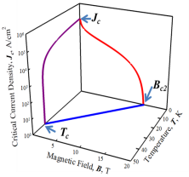
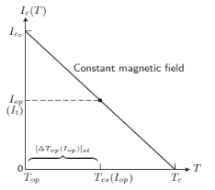
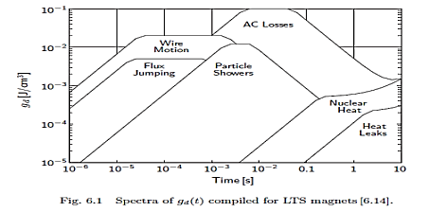


Q6: Is Nb₃Sn T margin too small for 16 T magnets?
Disturbances can cause a temperature rise, ΔT
If ΔT > T_{cs}-T_{op}, current will be shared to the matrix, and the strand will quench
Since T_{c} (thus T_{cs}) ↓ as B ↑, any strand has less “margin” at higher B, all else being equal
Question: Is our margin at 16 T too small?
IWASA
Q: But we know that higher J_{c} makes a strand more unstable, right?
A: This sort of instability is important of lower fields where J is much higher, and the energy storage (integrated heat capacity) is less than the energy due to the FJ (∝J_{c})
Of course, small filaments are needed for lower field FJ stability
If at 14 T, we are at 82% I_{op}, then at 16 T, T_{margin} is reduced by 18%. Or, to keep T_{margin}, I_{op}/I_{c} reduced 4%
Overall Answer: Nb₃Sn high field margin is a function of B and I/I_{c}
Higher J_{c} can help achieve higher margin , with some J_{c} going to performance, and some to lower I/I_{c} and thus increased margin

Slide 20
Q7: Can we realize this in a multifilamentary ternary?
We will show below our progress on multifilamentary strands
Ternaries are now being pursued, and we have several promising designs

Slide 21
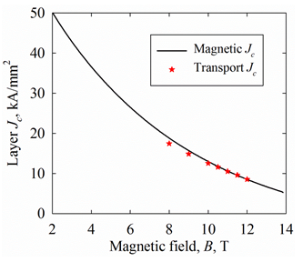
Results for a Binary subelement
Transport layer J_{c} and magnetic layer J_{c} of the subelements
So,
first we must translate this result into a multifilament
Then we must realize this in a ternary alloy strand

Slide 22
Factors which Influence A15 grain size in the internal oxidation method
There are three key parameters which need to be optimized for a given strand (subelement) design;
(1) the level of SnO₂ powder
(2) the thickness of the Nb-Zr alloy
(3) The local concentration (chemical potential) of the SnO₂ (oxygen) near the Nb-Zr alloy boundary
(4) the pre-HT schedule (time for oxygen injection)
The first two are important because together they set the all-important SnO₂ to Nb ratio and Nb to Sn ratio.
Too little SnO₂ and no oxidation, and thus no grain refinement occurs.
Too much, and the Nb as well as the Zr will be oxidized – leading to an oxygen impervious niobium-oxide barrier at the inner wall of the tube

Slide 23
Factors which Influence A15 grain size in internal oxidation method II
(3) The local concentration (chemical potential) of the SnO₂ (oxygen) near the Nb-Zr alloy boundary
(4) the pre-HT schedule (time for oxygen injection)
The third and forth are important because they set the rate, and time for, respectively, the oxygen injection into the Nb-Zr.
In fact all of the oxygen which is injected into the Nb is done before the A15 formation reaction.
To promote oxidation (and thus grain refinement) we can use; (i) more SnO₂ powder, (ii) less Nb1%Zr alloy, (iii) slower ramp rates.
Because of the differences in chemical potential depending on how the SnO₂ powder is deployed (a dense layer, or distributed) these ratios and optimizations are different for different strand designs

Slide 24
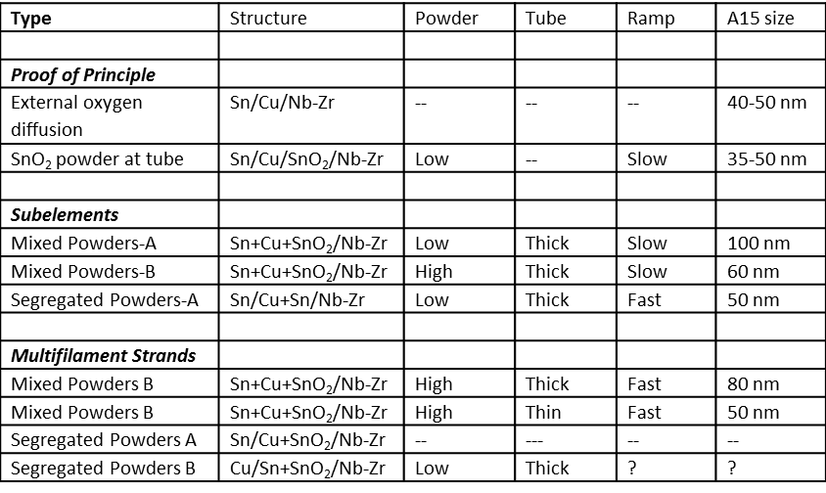
Simple Summary of Mono/Multi Strands

Slide 25
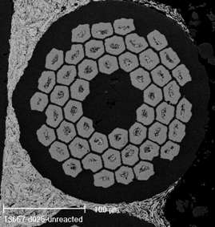
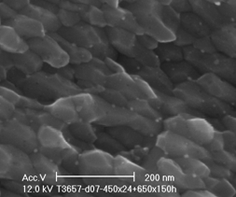
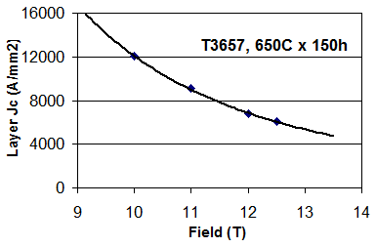
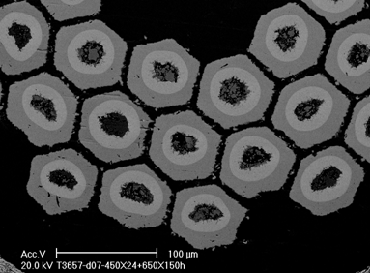
Thick Nb barrier 61 restack- HTR
Grain size = 80 nm
J_{c} 12 T = 6800 A/mm²

Slide 26
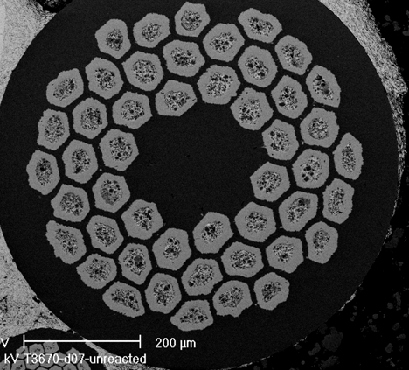
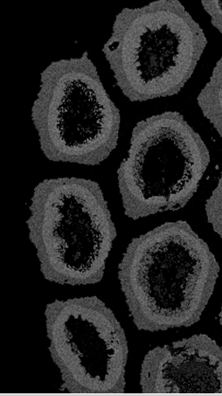
Thin Nb barrier 61 restack- HTR
Unreacted strand
Grain size = 50 nm
Reacted strand

Slide 27
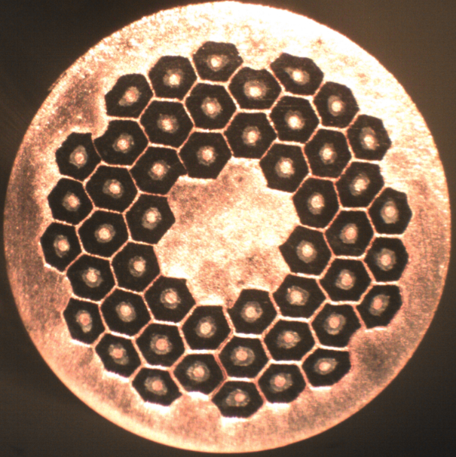
Segregated Powders B- 61 restack- HTR
Fabricated to Final size and being reacted

Slide 28
Multi-filamentary PIT strands-Supramagnetics
S120B-625C/680h:
B, T | 11 | 12 | 12.5 | 13 | 13.25
I_{c}, A | > 220 | 182.8 | 157.9 | 136.0 | 123.8
n-value | - | 24.6 | 21.3 | 20.6 | 18.8
The average grain size: 40 nm.
12 T J_{c} = 8700 A/mm²
Assuming 25% of the filaments are broken: need improvement!
220A: limit of the power supply.
Transport J_{c} matches magnetic J_{c}.

Slide 29
A naive look at the limits of J_{c} in Nb₃Sn
(Rosy scenario)
Engineering J_{c} and I_{c} for the five different cases:
 |  | I. Present state-of-the-art RRP strands | II. The wire with SnO₂ - 625 C / 800h | III. Only improve B_{irr} to 25 T by Ti doping, etc. | IV. Only refine the grain size to 25 nm | V. Both improve the B_{irr} to 25 T and refine the grain size down to 25 nm
Grain size, nm |  | 100 - 120 | 36 | 36 | 25 | 25
F_{p}-B peak |  | 0.2B_{irr} | 0.34B_{irr} | 0.34B_{irr} | 0.5B_{irr} | 0.5B_{irr}
F_{p,max}, GN/m³ |  | ~90 | 180 | 180 | ~250 | ~250
B_{irr}, T |  | 25 | 20 | 25 | 20 | 25
12 T | Layer J_{c}, A/mm² | 5,000 | 9,600 | 16,400 | 20,000 | 20,800
 | Non-Cu J_{c}, A/mm² | 3,000 | 5,760 | 9,840 | 12,000 | 12,480
 | Engineering J_{c}, A/mm² | 1,600 | 3,050 | 5,200 | 6,360 | 6,600
 | I_{c}, A | 800 | 1,530 | 2,620 | 3,200 | 3,320
15 T | Layer J_{c}, A/mm² | 2,700 | 3,800 | 7,800 | 12,500 | 16,000
 | Non-Cu J_{c}, A/mm² | 1,600 | 2,280 | 4,680 | 7,500 | 9,600
 | Engineering J_{c}, A/mm² | 850 | 1,210 | 2,480 | 4,000 | 5,100
 | I_{c}, A | 430 | 610 | 1,250 | 2,000 | 2,560
Note: Assuming all the five cases have the same Nb₃Sn area fraction with the state-of-the-art RRP strands:
the Nb₃Sn area fraction in a subelement is 60%, the non-Cu area fraction in a strand is 0.53, the wire diameter is 0.8 mm.

Slide 30
But, how realistic?
We cannot forget to include the area needed for the powder (we will do that next slide)
Can we really push the F_{p} to 0.5? (It seems that we are well on our way)
Can we really make multis (it seems so, but more process development is required)

Slide 31
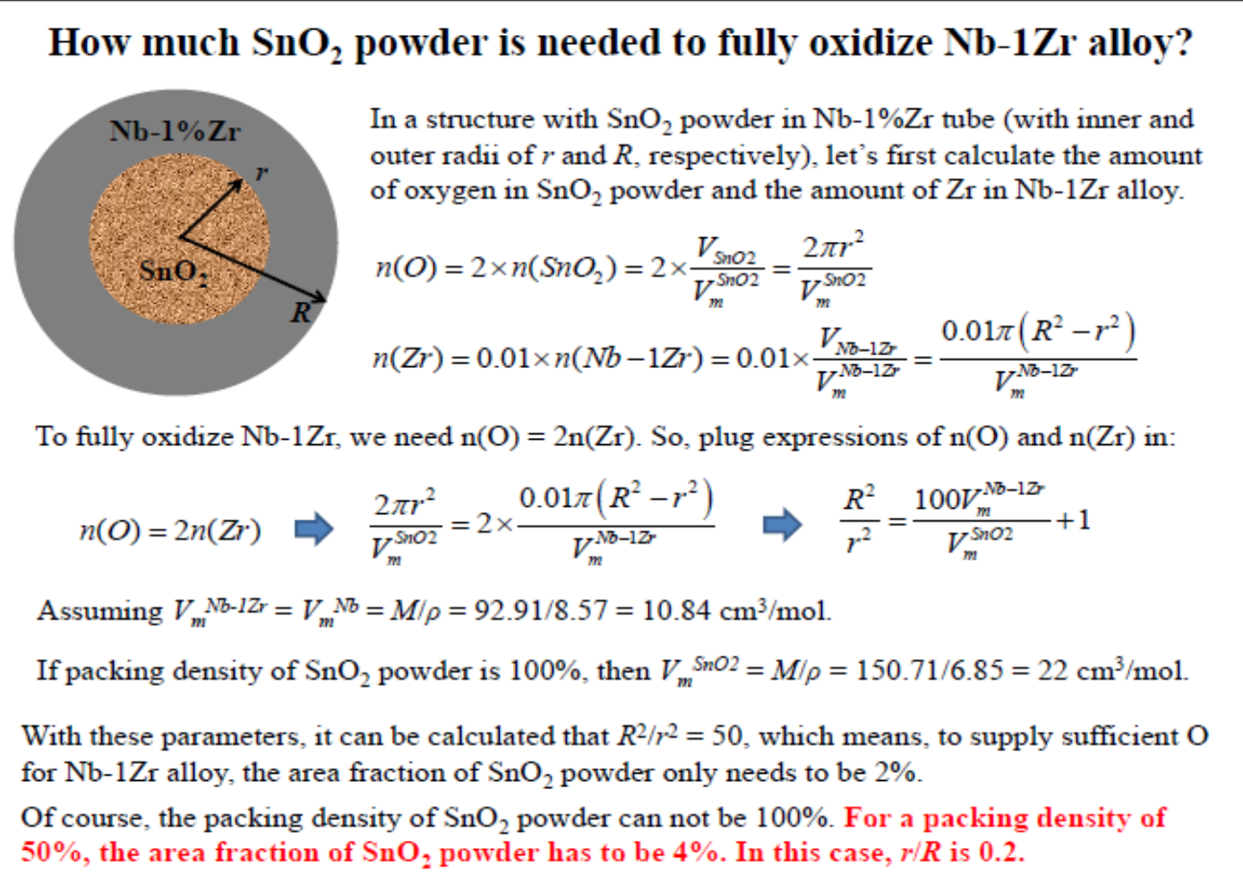
4% area needed for oxide powder

Slide 32
Practical Conductor J_{c} and J_{e} (12 T)
Layer J_{c} of present day RRP, Tube and PIT is 5000 A/mm², with 60% A15 in subelement for RRP, and 50% for PIT and Tube
At 15 T J_{c} is 2700 A/mm², J_{c,nonCu} (RRP) = 1600 A/mm², and Tube/PIT 1350 A/mm²
4% (volume or area)is required for the SnO₂ powders
At 12 T
Using 1% Zr, with full oxidation, and moderate temperatures, layer Jc of 10 kA/mm² seen at 12 T in mono
Assuming 50% fill factor, J_{c,nonCu} (12 T) should reach 4750 A/mm²
If we can implement in a RRP-like design, then J_{c,nonCu} (12 T) should reach 5760 A/mm² in Binary

Slide 33
Practical Conductor J_{c} and J_{e} II (15 T)
Layer J_{c} of present day RRP, Tube and PIT is 5000 A/mm², with 60% A15 in subelement for RRP, and 50% for PIT and Tube
At 15 T J_{c} is 2700 A/mm², J_{c,nonCu} (RRP) = 1600 A/mm², and Tube/PIT 1350 A/mm²
4% (volume or area)is required for SnO₂
At 15 T
Using 1% Zr, with full oxidation, and moderate temperatures, layer J_{c} of 3800 A/mm² extrapolated from 14-15 T in mono
Assuming 50% fill factor and mixed powders, tube J_{c,non} (15 T) should reach 1805 A/mm² (Binary)
If we used an RRP-like design, then J_{c,nonCu} should reach 2165 A/mm² 15 T (Binary)
With ternary push of B_{c2} to 25 T, a significant further increase would be seen at 15-18 T

Slide 34
Comment and Simple Scaling Rules
While Internal Sn strands have greater A15 fractions, they may be more difficult to fabricate
Its likely that the best deff values for these new conductors will be seen with Tube and PIT
Thus, efforts in Tube and PIT are important, especially since ….
If we simply add grain refinement to a given Nb₃Sn alloy (say, ternary) and do not shift the peak of B_{c2}, we can expect J_{c} to double at all fields
If we push the peak out the effects are greater still

Slide 35
So, What can we expect for a ternary Tube or PIT
If we assume pinning similar to what we have already produced, with a 1% Zr alloy, and a 35-40 nm grain size
And we use standard ternary alloying to reach Birr = 25 T
Then we expect a layer Jc = 7800 A/mm2 at 15 T
At 16 T, this should reduce by 30% to 5460 A/mm2
With a 50% A15 fill factor, this gives 2750
With room for the oxide, this gives 2600 A/mm2 at 16 T as a projected possible value
This does not include
  (1) maximized Bc2/Birr from modified doping or optimized HTs
  (2) Peak shifting from 0.35-0.5
  (3) further grain refinement (2% Zr)
This gives a projected value of 2600 A/mm², which more than meets 1500 A/mm²

Slide 36
So…. How to add the ternary?
We choose Ti, as it leads to a better strain tolerance conductor – and, it can be added to the allow after drawing
But – you can’t add it in the same area as the SnO2 – because Ti is a powerful oxygen getter
Sn+Ti
Nb
SnO2
Pre-HT
Reaction
So, its possible to add it into the Nb-Zr to start – but we plan to add it afterward

Slide 37
E.Barzi--Artificial Fluxon Pinning Centers for Nb₃Sn (film Test bed)
The discussion so far has been about artificial pinning of grain boundaries (or perhaps enhanced nucleation), but what about standard artificial fluxon pinning centers
This topic will also be addressed in the next talk using irradiation as a limiting case. But, in the end we want a more practical second phase pinner
Staggered Electrodeposition could be a mechanism to produce such structures (additive manufacturing of pinning centers in Nb3Sn).
Below we show an inexpensive way to produce Nb₃Sn thin films on Nb, and it can be used as a test bed to try different billet materials inexpensively and with fast turnaround
Our first target: The Introduction of axial ribbons to enhance transverse component of pinning
We have to come up with ribbon materials that can be cold worked, do not dissolve at 700C and do not react with Sn. Potential candidates so far are Ta, Mo and V.

Slide 38
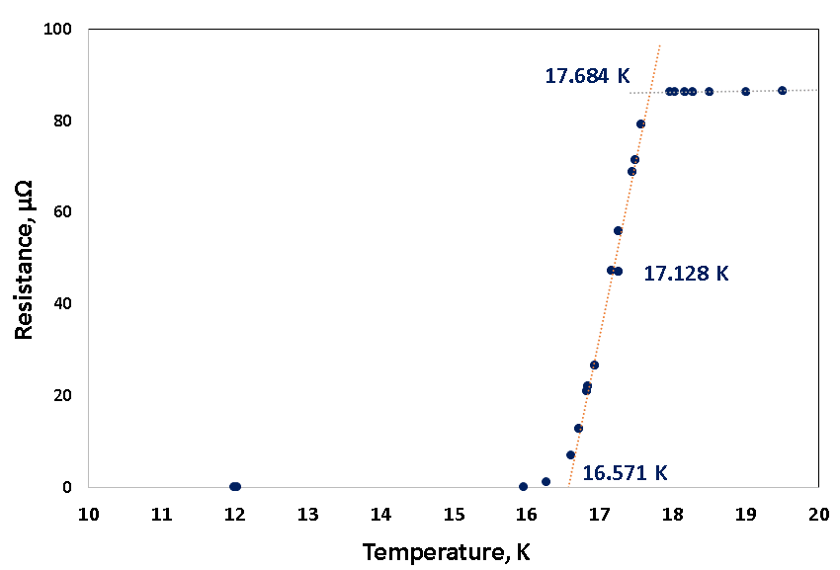
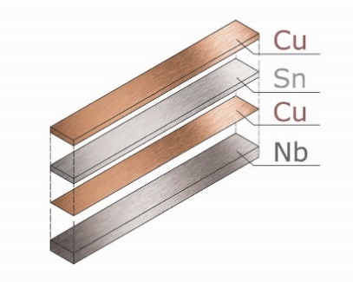
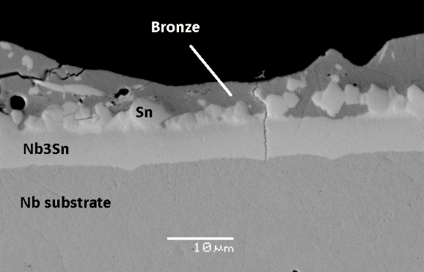
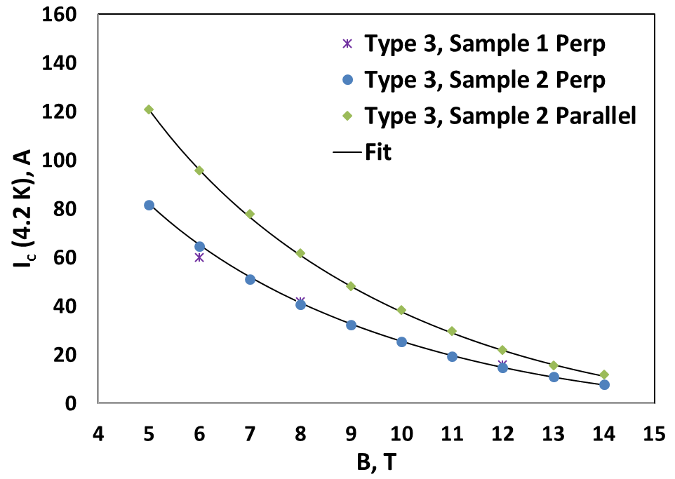
E.Barzi--Artificial Fluxon Pinning Centers for Nb₃Sn (film Test bed)
The Nb₃Sn phase is obtained by electrodeposition of Sn layers and Cu intermediate layers onto Nb substrates followed by high temperature diffusion in inert atmosphere.
Subsequent thermal treatments were realized to obtain the Nb₃Sn superconductive phase.

Slide 39
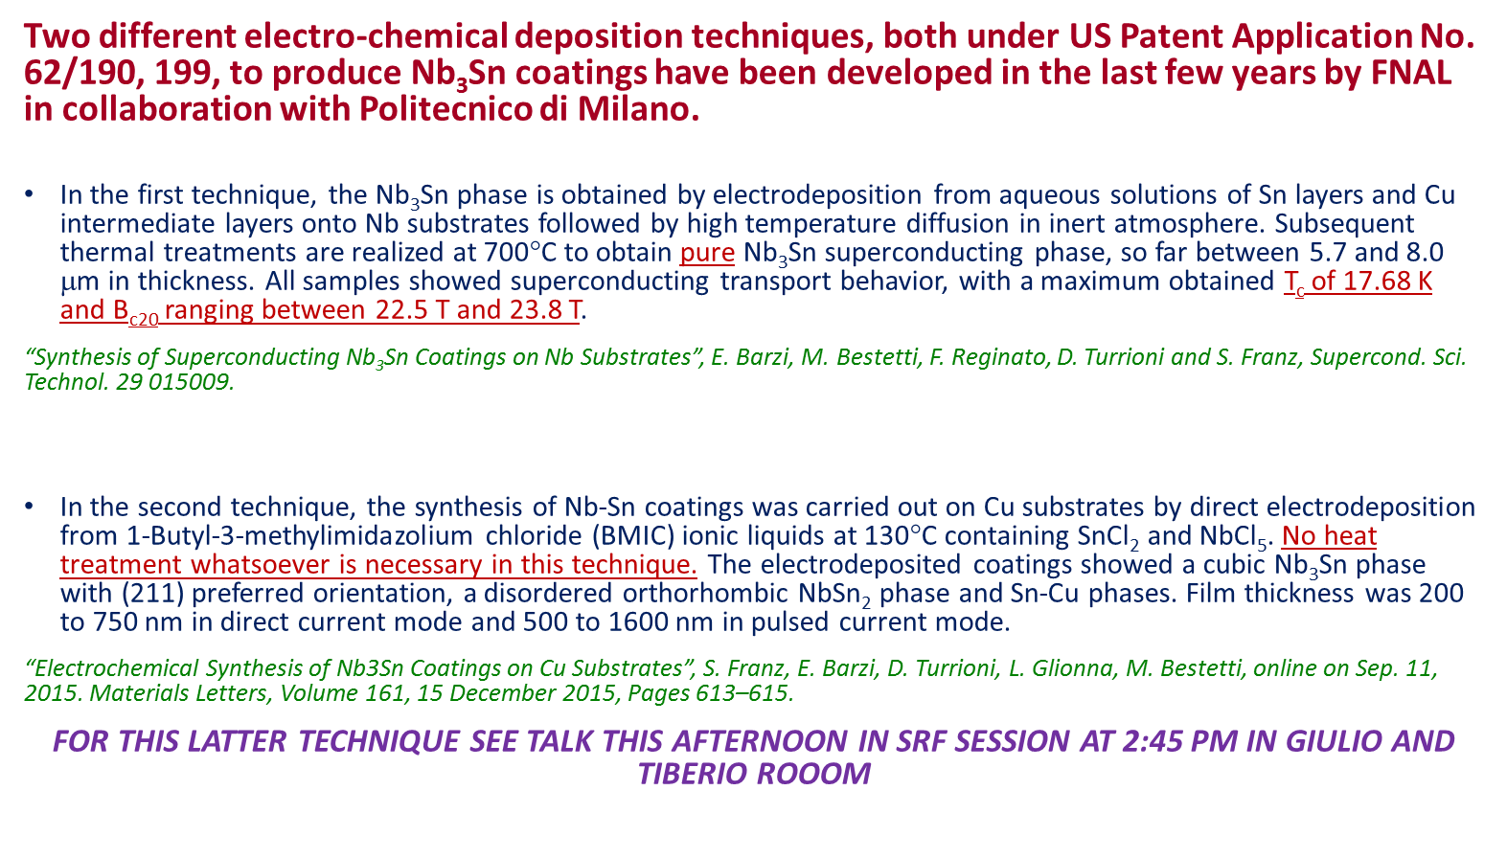
E.Barzi--Artificial Fluxon Pinning Centers for Nb₃Sn (film Test bed)

Slide 40
Summary and Conclusions
We have demonstrated grain refinement by a factor of 3 and a doubling of 12 T J_{c} in monofilaments
Internal oxidation can be used in many Nb₃Sn strand types, including Tube (demonstrated) PIT (demonstrated), RRP/RIT (proposed) etc.
Sufficiently thick reaction layers can be formed
It is shown that B_{irr} is not sacrificed in present best binary strands
The F_{p}-B curve peak can be shifted to 0.5B_{irr} for ultra-fine grain size
Multifilamentary strands have been demonstrated with refined grains and enhanced Jc values. These need
  To be pushed to meet the even higher J_{c} values of their subelements
  To be optimized for area fraction and J_{e}
  To be demonstrated for a ternary alloy with the ternary alloy B_{c2}
This route is very promising for future Nb₃Sn development

Slide 41
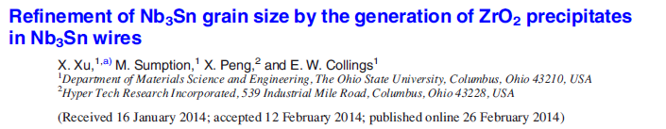
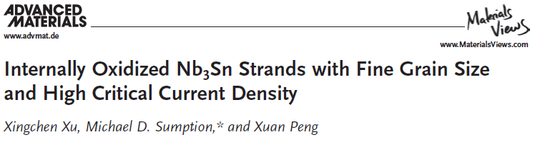
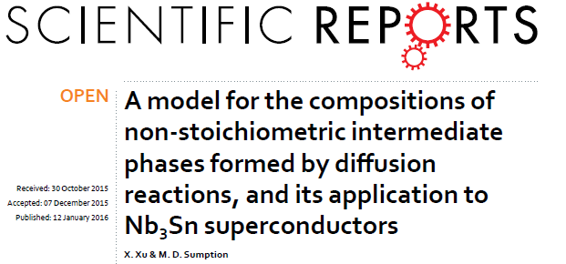
Xingchen Xu
Recent graduate of our group
PhD Thesis, OSU Materials Science Department: Prospects for Improvement in Nb₃Sn conductors
Refined grain and high J_{c} Nb₃Sn
New model for what controls stoichiometry in Nb₃Sn

