Slide 1
Influences of Doping, Porosity, and Anisotropy on the Critical Currents of Magnesium Diboride Wires
M.A. Susner
M.D. Sumption
G.Z. Li
Y. Yang
and E.W. Collings
M.A. Rindfleisch
M.J. Tomsic

Slide 2
Acknowledgements
This work was funded by the Unites States Department of Energy, Office of High Energy Physics and the State of Ohio
A portion of the data in this work was collected at the National High Magnetic Field Laboratory at Florida State University

Slide 3
Summary of Unanswered Questions in MgB₂
How do we separate intrinsic properties like J₀, B_{c2} and γ from extrinsic effects like porosity and the presence of blocking phases ?
What are the influences of B_{c2}, γ, porosity, and connectivity on J_{c}, F_{p}(B)?
Have compared microstructure and superconductive properties of three different systems to isolate these effects
PIT (porous, randomly oriented)
IMD (dense, randomly oriented)
Films (dense, aligned)

Slide 4
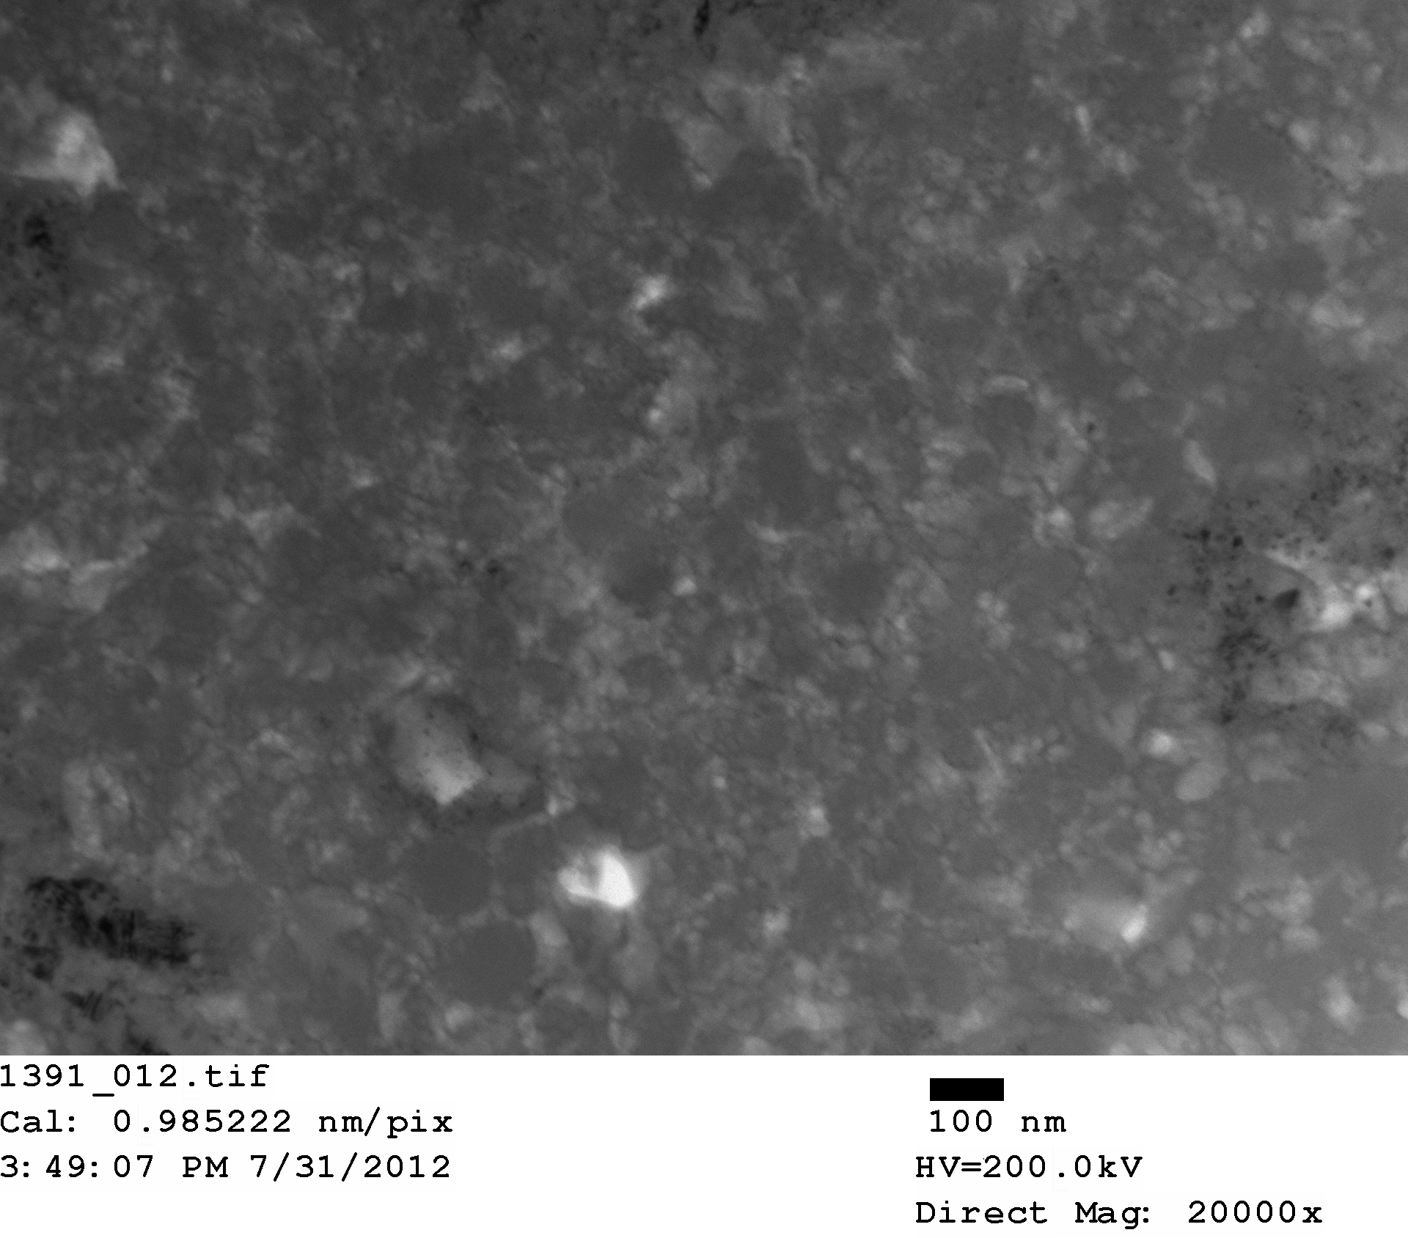
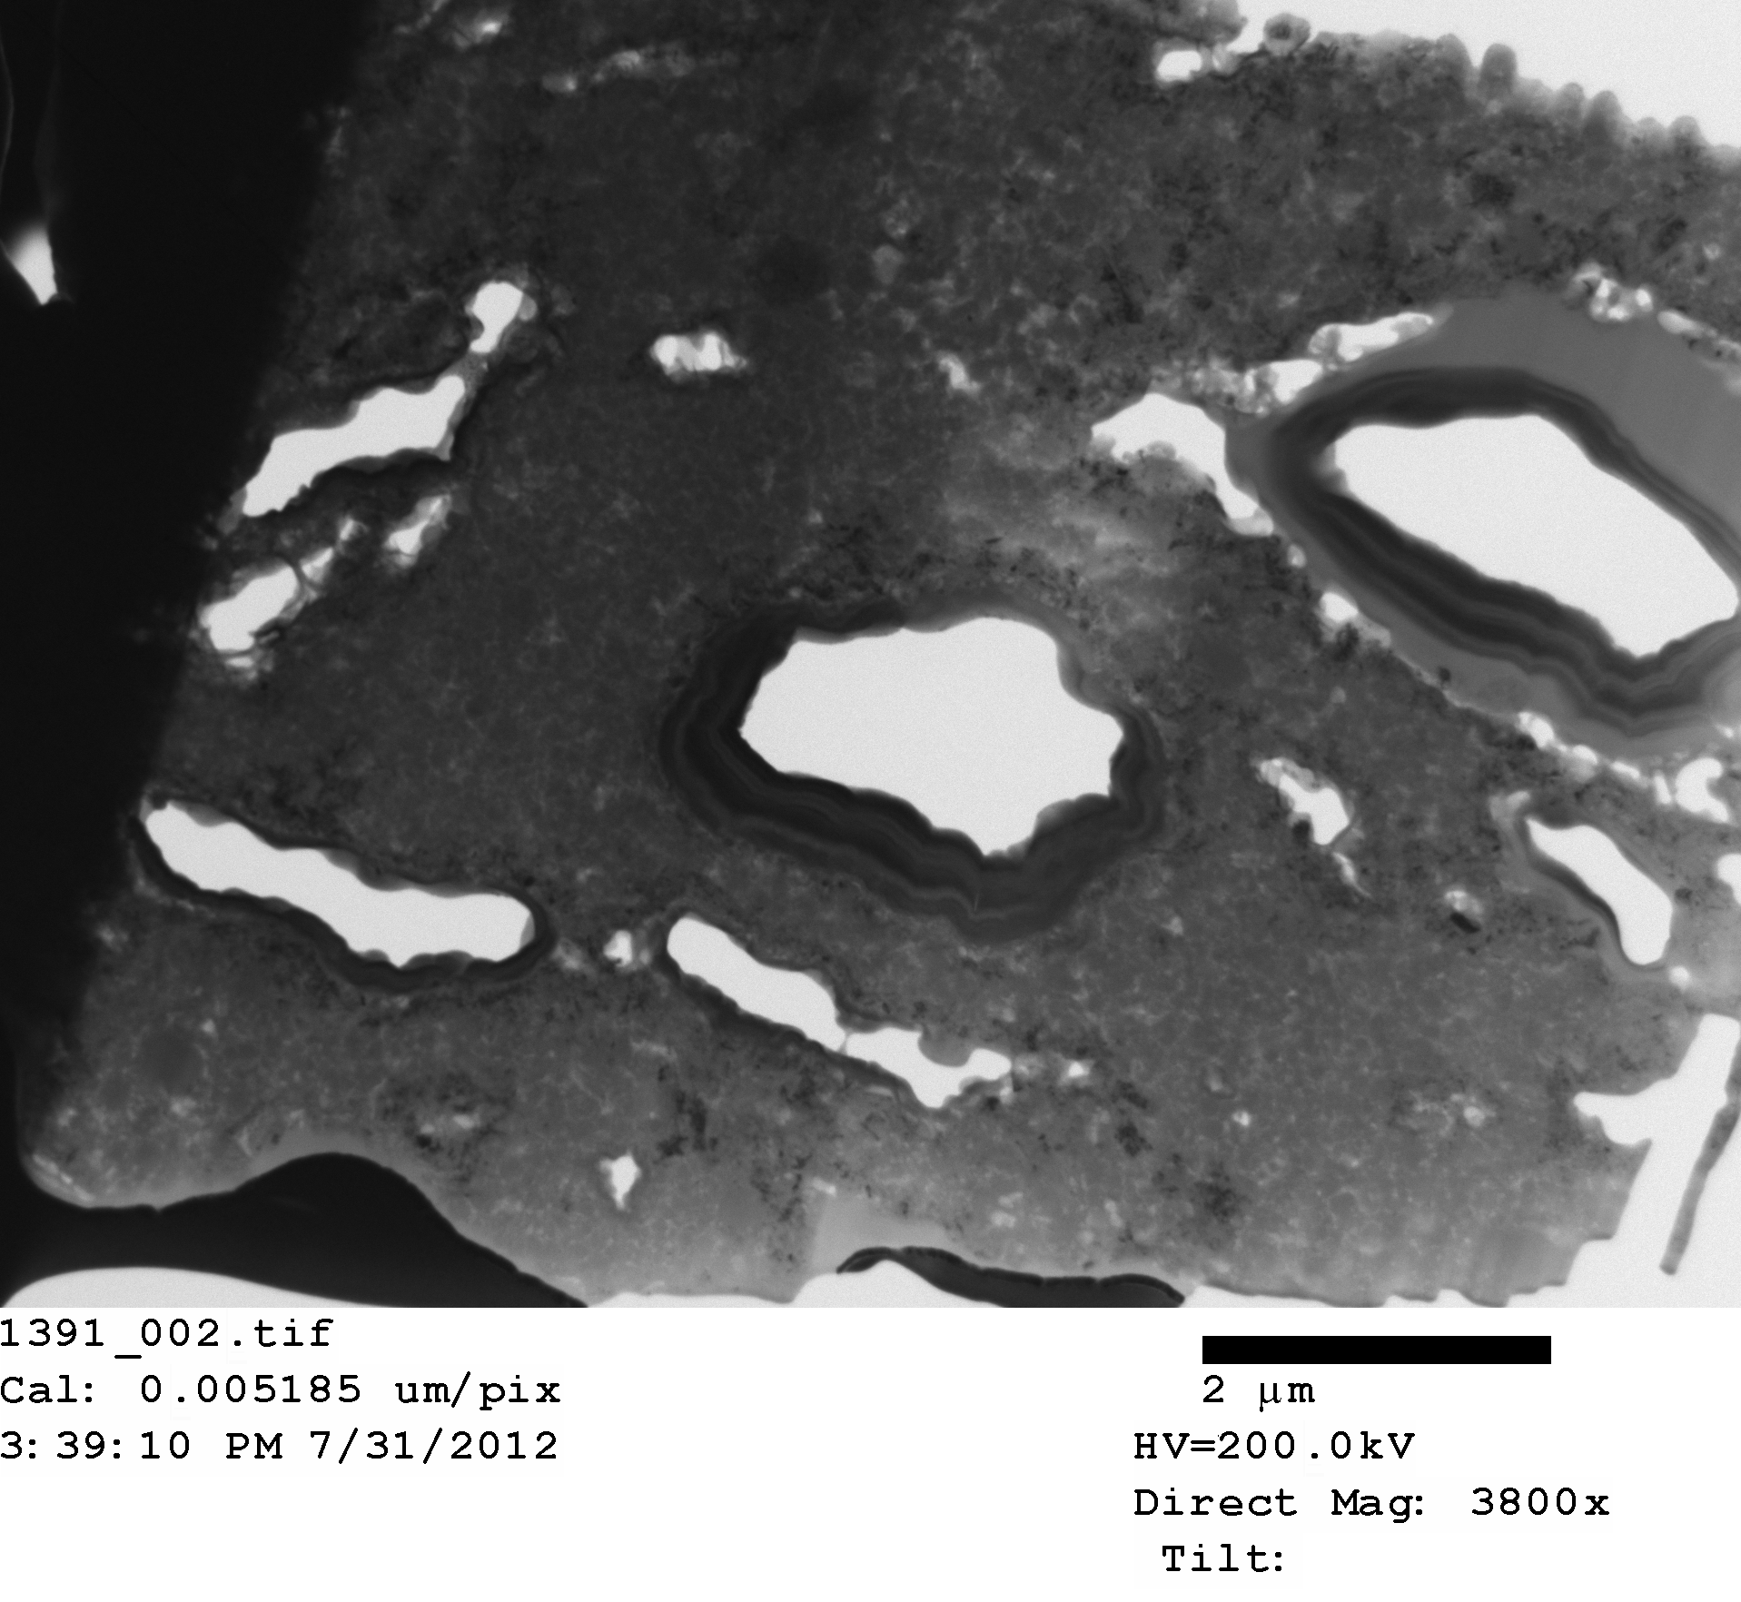
BF TEM MgB₂ wire x-section
MgB₂ wires consist of randomly oriented, polycrystalline grains ~50-100 nm in size, largely dependent on prior B size
FIBed MgB₂ wire x-section

Slide 5
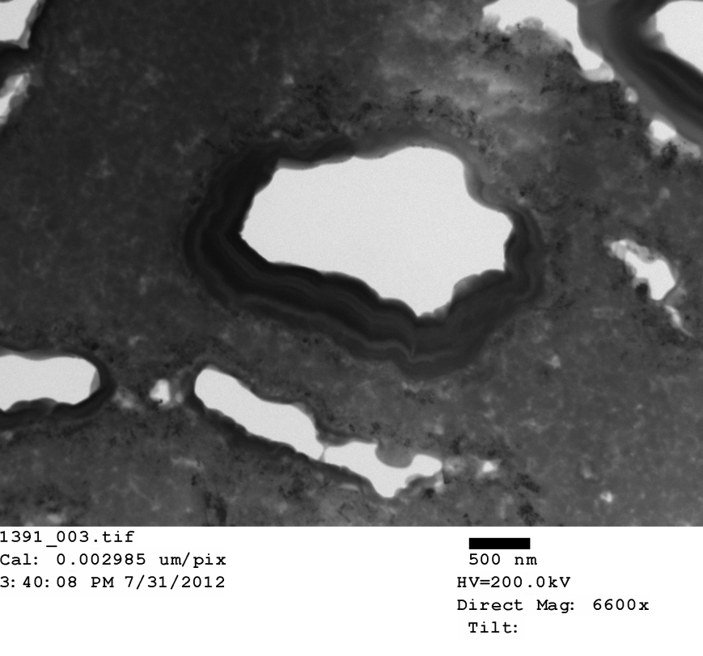
TEM- PIT wires
Mg readily passivates- forms MgO and Mg(OH)₂
Drawing deforms the Mg, creating fresh surfaces
HT (where the prior Mg, through vapor diffusion, infiltrates the B to form MgB₂) leaves behind MgO
See MgO surrounding every prior Mg stringer
If we assume this cross section is representative of the entirety of the sample, then we see only 47% of the sample is free of porosity, MgO, or other second phases

Slide 6
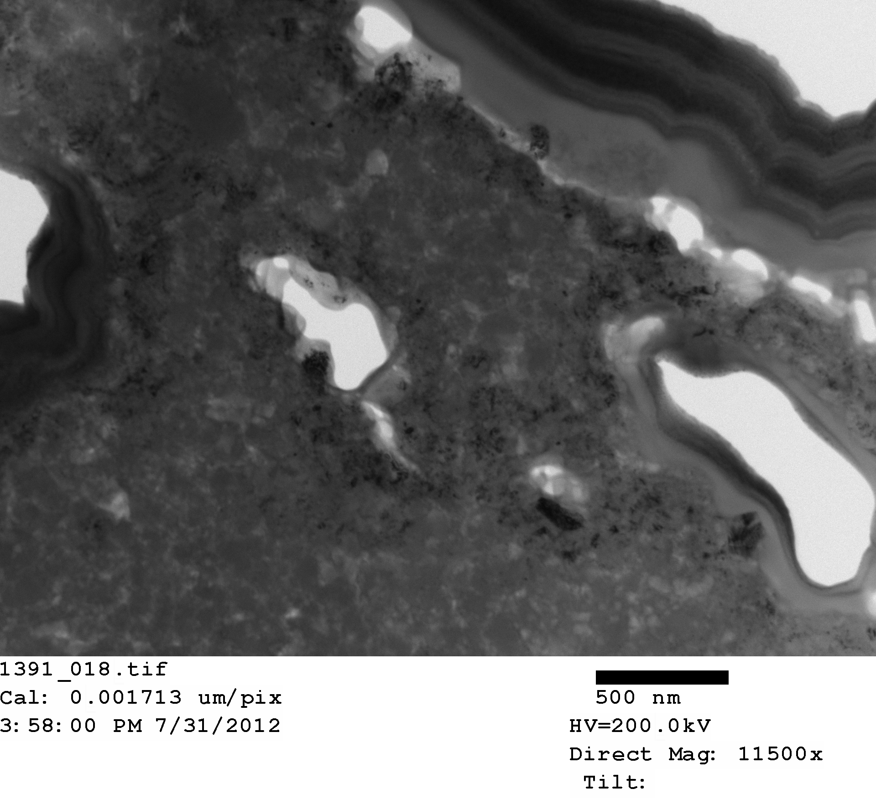
TEM- PIT wires
These MgO precipitates and the high degree of porosity serve to inhibit connectivity (i.e. supercurrent flow) in MgB₂ wires
Summary:
PIT wires both
-randomly oriented
-porous and poorly-connected

Slide 7
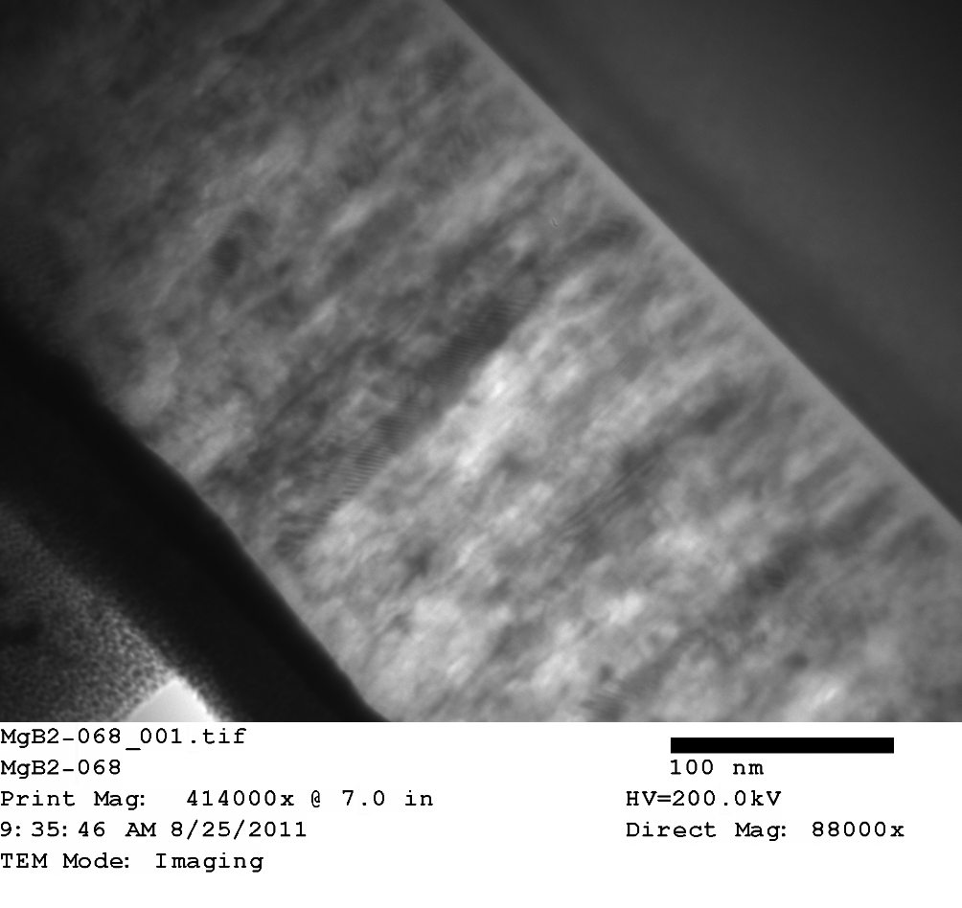
PLD synthesized thin films
Pt cap layer from FIBing
MgB₂
PLD-synthesized MgB₂ thin films result in c-axis oriented thin films
Randomly oriented in-plane, columnar grains
SiC
Summary:
MgB₂ thin films both
-c-axis aligned
-well-connected
500 nm
SiC
MgB₂
200 nm
Pt

Slide 8
Comparison of superconductive properties?
Normalize to B(F_{p,max})
Polycrystalline randomly oriented grains in wires yield significant deviations at high b when combined with high porosity
Thin films and dense wires deviate less
Therefore, it is reasonable to assume that Porosity and connectivity are as large of an influence as the intrinsic anisotropy
Let’s quantify this…

Slide 9
Quantifying effects of porosity and anisotropy
Here we use Eisterer’s analysis for percolative current paths in MgB₂
M. Eisterer, M. Zehetmayer, and H. W. Weber (2003) Phys. Rev. Lett., 90(24) 247002 and M. Eisterer et al. (2009) SuST 22(3) 034016.
Straley and Kenkel modeled a network of non-linear I-V resistors following the power law
See Phys Rev. Lett. 49(11) 767-770 (1982) and Phys. Rev. B 29(11) 6299-6305 (1984)
For a superconductor, α = ∞ & t = 1.76
Deutscher et al. J. Phys., Lett. vol. 40, no. 10, pp. 219–21, 1979.
p is probability that a component of the network is conducting
p_{c} is percolation threshold (minimum fraction of conducting regions for cont. current path)
p is probability that a grain is superconducting
p_{c} is percolation threshold
p_{s} is phase fraction (excluding pores, secondary phases, &c.)

Slide 10
Applying the model for MgB₂
Here we use Eisterer’s analysis for percolative current paths in MgB₂
For an anisotropic superconducting material…
Create a network of 10⁴ grains, each with (sin θ) randomly distributed between 0 and 1
For a grain-boundary pinned superconducting material…
0º: “out-of-plane” B_{c2}- lower value
90º: “in-plane” B_{c2}- higher value
What are the effects of each of these variables?

Slide 11
Anisotropy
Use a model undoped MgB₂ system:
-J₀: 5x10⁶ A/cm²
-B_{c2}: 20 T
-p_{c}: 0.2- densely packed system
Increasing γ causes a decrease in the amount of supercurrent percolation paths
As a result, J_{c} at high B decreases – this effect intensifies with increase in γ
Increase γ

Slide 12
Percolation Threshold
Anisotropy (γ) fixed to 2.5
This value is lower than that seen in single crystals or thin films but typical for what is seen in wires (B purity, grain size, defects)
Increasing p_{c} a more subtle effect than anisotropy- effect small at low B, large at high B
Increase p_{c}

Slide 13
Porosity
Anisotropy (γ) fixed to 2.5
p_{c}: 0.2
B_{c2}: 20T
J₀: 5x10⁶ A/cm²
Porosity globally decreases J_{c}(B)
decrease p_{s}
Increase porosity

Slide 14
Fitting Percolation Model to Real Wires
Need to fit 5 parameters:
γ, p_{c}, p_{s}, B_{c2}, J₀
Can obtain experimental values for γ, B_{c2}, J₀
Can make the assumption that p_{s}=0 (or close to it) for IMD samples, leaving just one parameter necessary for fitting: p_{c}

Slide 15
Finding B_{c2}

Slide 16
Finding B_{c2}
B_{c2,0K} ~ 30 T

Slide 17
Anisotropy
Isolating γ for a nano-polycrystalline material is problematic
Can estimate based on:
M. Eisterer, M. Zehetmayer, and H. W. Weber (2003) Phys. Rev. Lett.
When we assume 0.2<p_{c}<0.3
(reasonable estimate typical to literature)
we get 2.1<γ<3.1
Now we have reasonable starting values for J₀, γ, and B_{c2}

Slide 18
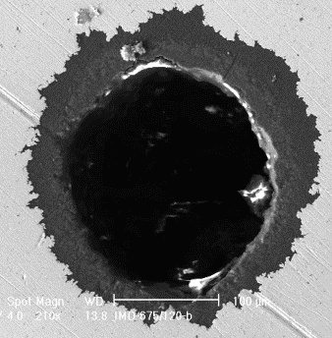
IMD, 2% C-doped
Used experimentally determined γ, J₀, B_{c2} for initial fitting parameters
IMD wire was assumed to be 100% connected (i.e. no porosity) in fitting
Assumption valid in comparison to PIT wires

Slide 19
PIT ~2% C-doped
Assumed properties within a fiber are the same as IMD → porosity/MgO layers only difference

Slide 20
Summary and Implications
 | MgB₂-IMD | MgB₂-PIT
J₀ | 1.1 x 10⁷ A/cm² | 1.1 x 10⁷ A/cm²
B_{c2} | 32 T | 33 T
γ | 2.6 | 2.6
p_{c} | 0.2 | 0.2
p_{s} | 1 | 0.67
p*= p_{c}/p_{s} | 0.2 | 0.30
A_{con}= [(p_{s}-p_{c})/(1-p_{c})]^{1.76} | 1 | 0.59
See M.A. Susner et al. (2011) SuST 24 012001/1-5
At 4.2 K, 10 T, the decrease in Jc seen in MgB₂ compared to a theoretical, dense, isotropic material is
~60% due to anisotropy
~40% due to porosity
Anisotropy limits high field J_{c} (not new)
Decreasing porosity can mitigate this effect
Additionally, anisotropy can be further reduced with increased doping

Slide 21
Next Step
Based on this understanding, and feedback with our collaborators at Hypertech…
Following the RLI process of Giunchi… one achieves good material density
Following Kumakura’s IMD results… one achieves good J_{c}
We get good J_{c} with SMI pre-doped nano-B as a result of increases in B_{c2}, decreasing porosity, and decreasing γ

Slide 22
Conclusions
Much research in MgB₂ focused on improving B_{c2}, F_{p}, J_{c}, &c.
A complete deconvolution of connectivity, pinning, anisotropy, B_{c2}, and porosity was possible using PIT, IMD, and thin film MgB₂ samples
Previous work has led to the conclusion that MgB₂ is not ideal for high field applications due to its anisotropy
Careful synthesis of wires with reduced anisotropy and porosity can increase high field properties (e.g. 10 T) by an order of magnitude
Application of percolation theory to MgB₂ wires of different designs isolated the effects of porosity and crystalline anisotropy. Unappreciated to date, porosity was seen to be just as important a factor as γ
In particular, at 10 T, 60% of supercurrent degradation comes from anisotropy, 40% from porosity
Can nearly eliminate the latter, reduce the former through doping

Slide 23
Questions?
Thank you!

