Slide 1
Mechanical properties of niobium tube with
tube bulge test for SRF cavities
2MOrC1-02
H. S. Kim
M. D. Sumption
M. A. Susner
and E. W. Collings
H. Lim
J. W. Lee
M. K. Lee

Slide 2
Outline
1. Purpose of the test
2. Description of experiment
3. Experimental results
1) OFHC Cu
- RRR/rr
- Tensile and Bulge tests
- Microstructural analysis
- Numerical simulation
2) Nb
- Tensile test
- Bulge test
- Numerical simulation
4. Concluding summary

Slide 3
Purpose
Testing the hydroformability using hydraulic tube bulge test
in preparation for the hydroforming of multi-cell cavities
welded nine-cell cavity
hydroformed nine-cell cavity

Slide 4
Experimental Materials
The Tube: OFHC Cu and Niobium
- OD: 2.5” = 63.5 mm
- Thickness: 1.65 mm
- OFHC Copper (Heat treated at 200 ~ 700 °C for 2 hrs)
- Niobium (Heat treated at 800 °C for 3 hrs and 1000 °C for 2 hrs)
2. RRR/rr measurement
4-point probes method
LHe, LN2, Ice water
2. The tensile sample
- Tensile test specimens were cut from the tube with an ASTM standard dimension.
- Strain rate: 0.002 /s

Slide 5
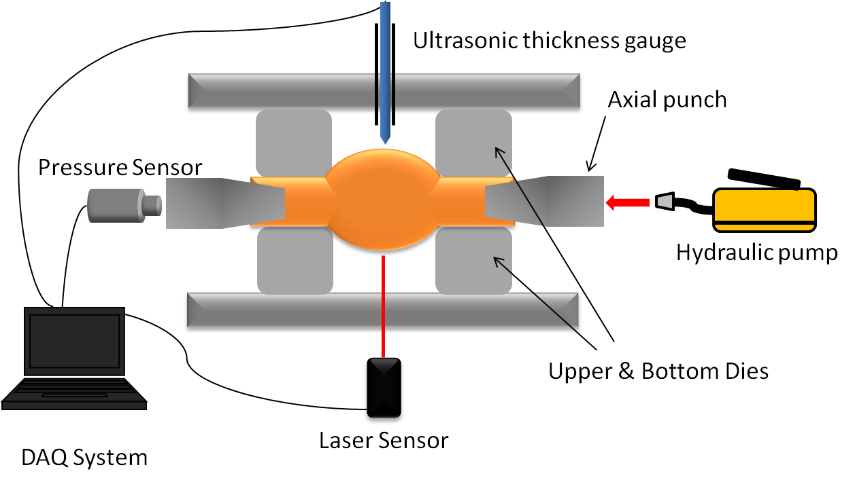
Hydraulic bulge test_(1)
Data Acquired:
Hydraulic pressure: manually adjusted, gauge measured
Bulge height: laser sensor
Tube thickness: ultrasonic gauge, sliding under gravity

Slide 6
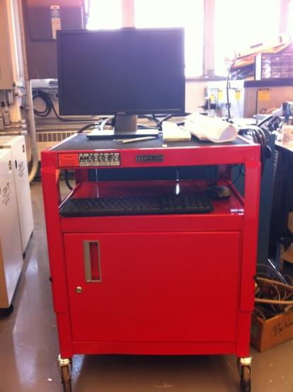
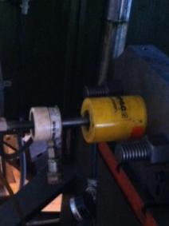
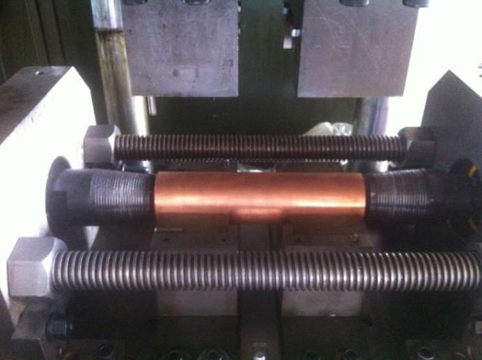
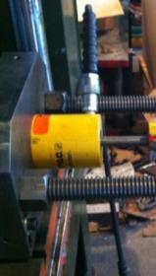
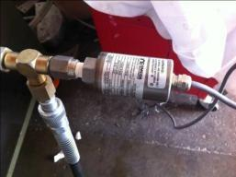
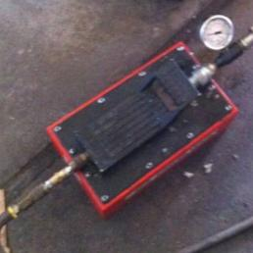
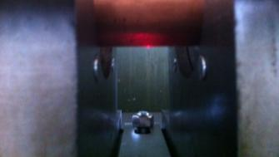
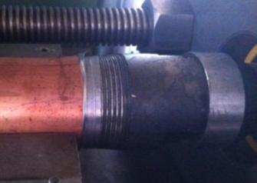
Hydraulic bulge test_(2)
Utrasonic Thickness Gauge
DAQ System
Upper and Bottom Dies
Cylinder for axial force
Pressure
sensor
Punch
Sealing Material
( Lead Foil)
Hydraulic Pump
Laser sensor(Bulge height)

Slide 7
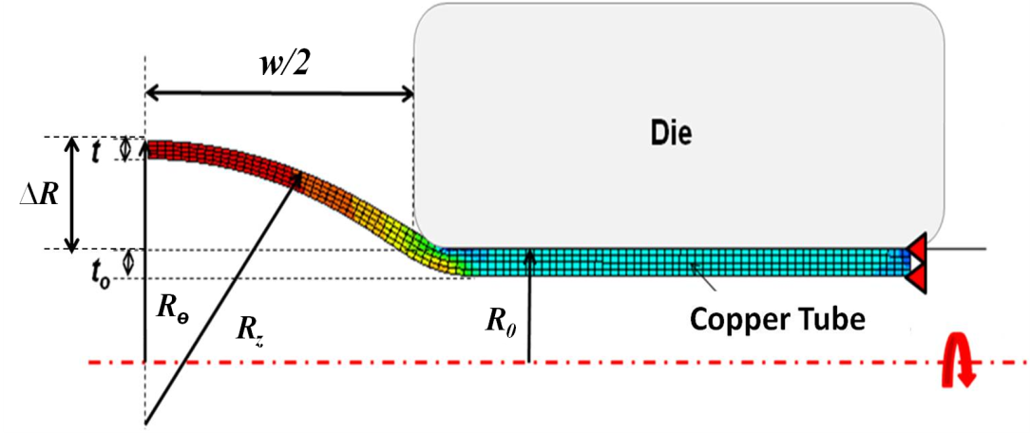
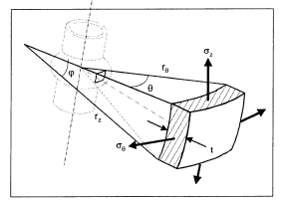
Bulge test analysis
(The bulge is circular in shape)
Koc et al.
(Force balance/Thin walled tube/Von Mises)

Slide 8
Numerical simulation
Program: ABAQUS/Explicit
Geometry
- Axisymmetry cross-section of the tube
- Only half tube was modeled
- The ends of the tube were constrained
- Four-noded solid elements (CAX4R)
3) Elastic properties
- Elastic Modulus: 115 GPa (OFHC)
4) Plastic Properties
- Effective stress – Effective plastic strain obtained from tensile and bulge tests
5) Yield function: Isotropic material (Von Mises)

Slide 9
OFHC Cu

Slide 10
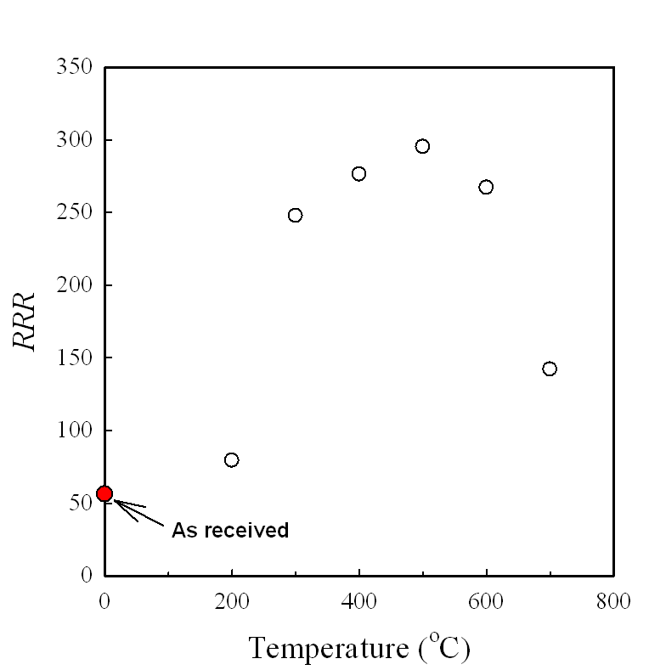
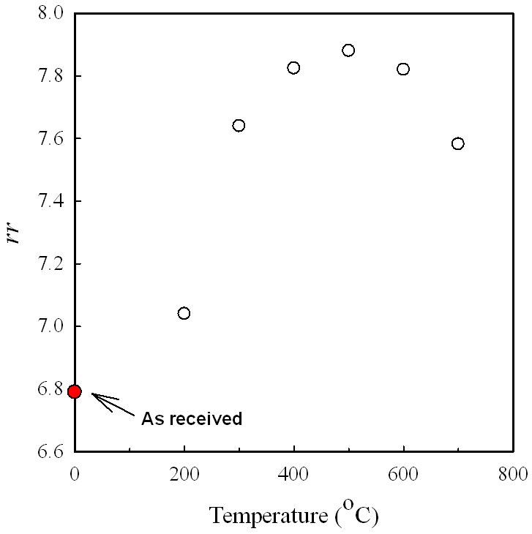
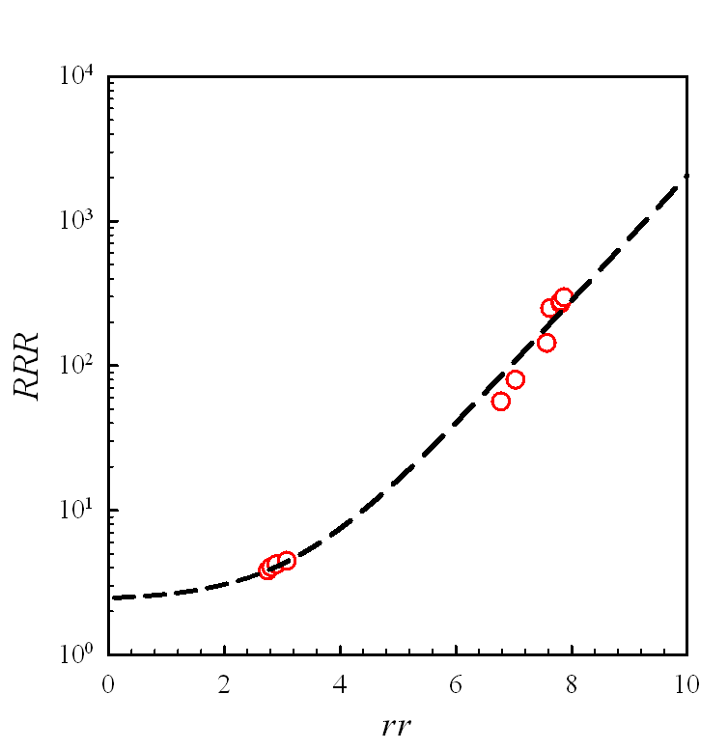
RRR and rr_OFHC Cu
RRR = 0.09355exp(rr)+2.3807
The sample heat treated at 500 °C shows the maximum RRR and rr values.

Slide 11
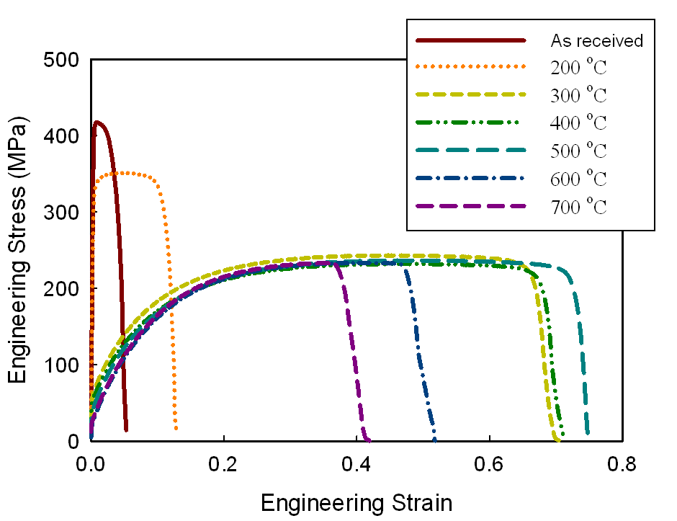
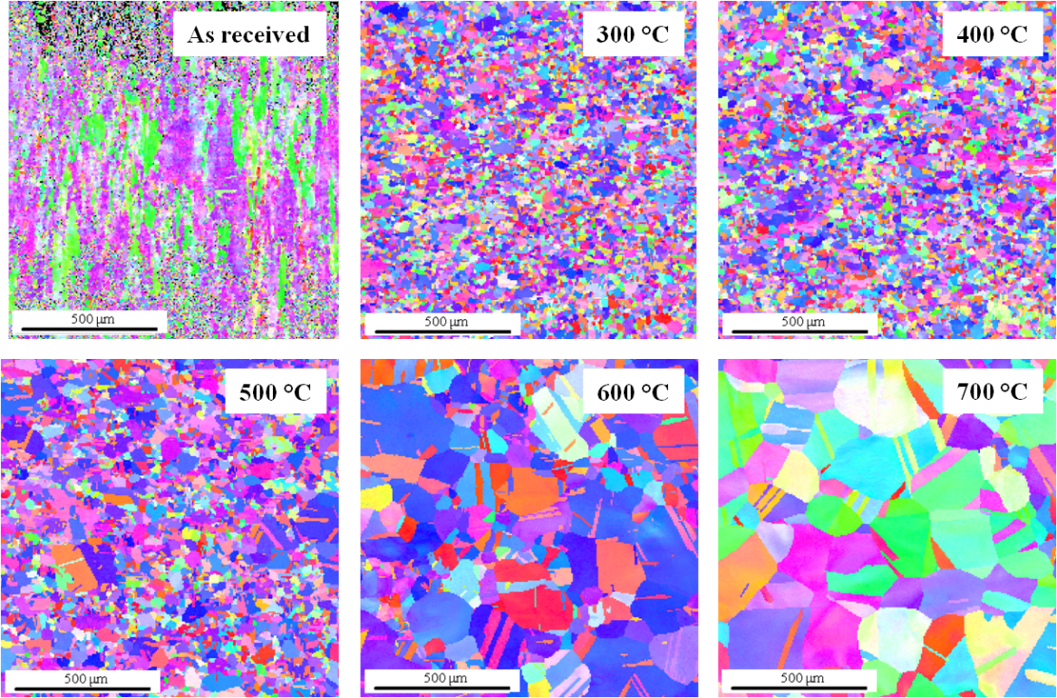
Tensile test results_OFHC Cu
Temperature [°C] | Yield Strength [MPa] | Tensile Strength [MPa] | Uniform elongation | Grain Size [μm]
As received | 412 | 417.56 | 0.01 | -
200 | 321 | 351.31 | 0.046 | -
300 | 60 | 243.34 | 0.46 | 14.2
400 | 53 | 242.41 | 0.46 | 14.7
500 | 38 | 236.77 | 0.49 | 17.1
600 | 23 | 233.56 | 0.42 | 31.4
700 | 27 | 233.40 | 0.35 | 58.7
The sample heat treated at 500 °C shows the maximum uniform elongation.

Slide 12
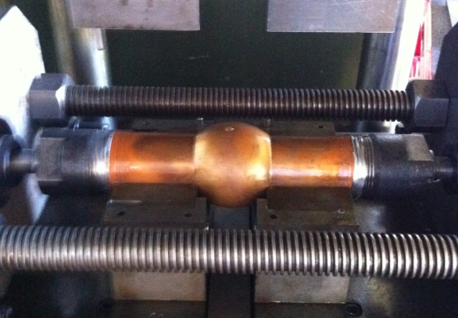
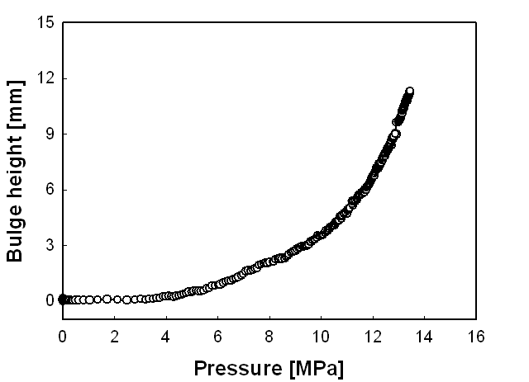
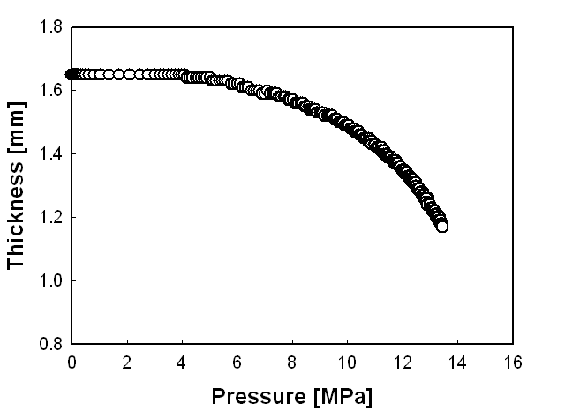
Bulge test results_OFHC Cu_(1)
OFHC_Cu Tube: Heat treated at 500 °C for 2 hrs

Slide 13
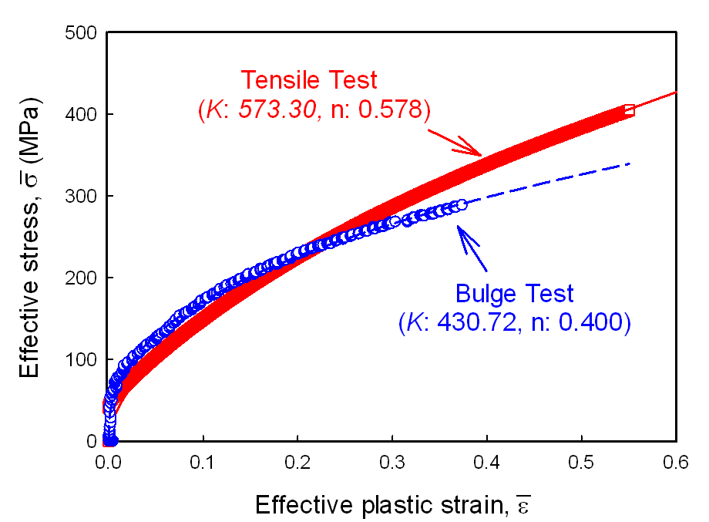
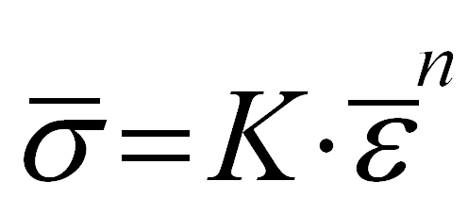
Bulge test results_OFHC Cu_(2)
Analytical model
Bulge test results
Effective Stress – plastic strain curve
Constitutive equation
Hollomon format
Use these plastic constitutive equations as a input for simulation

Slide 14
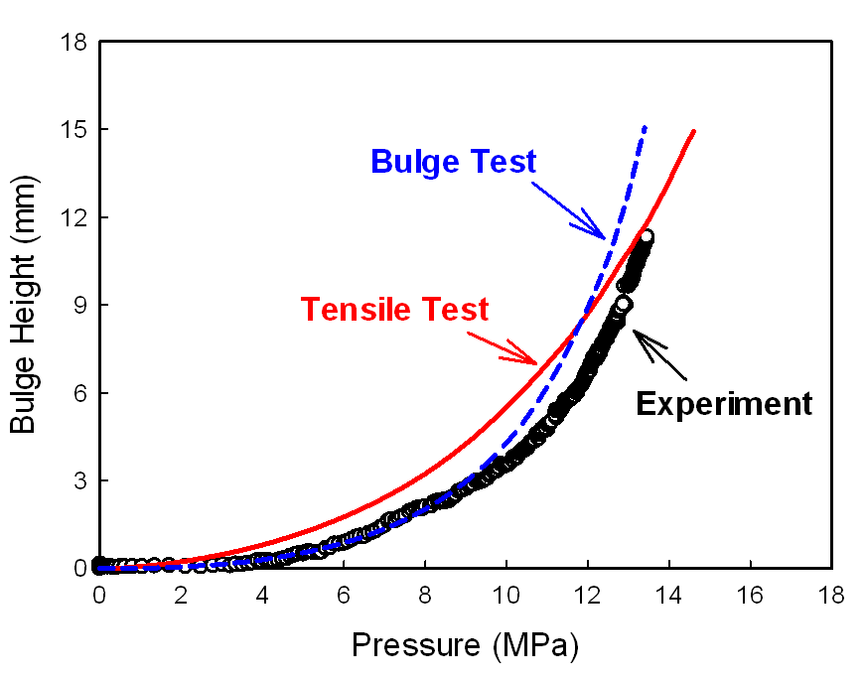
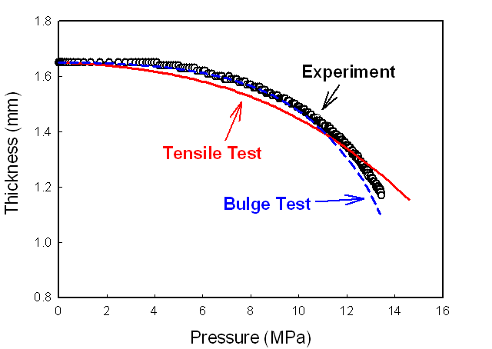
FEA Results_OFHC Cu
Combined simulation results using flow stress curves
from tensile test and bulge test
The simulation results using the flow stress curve from bulge test is well matched to the experimental data below ~10 Mpa.
Causes: anisotropic properties, asymmetric deformation

Slide 15
Niobium

Slide 16
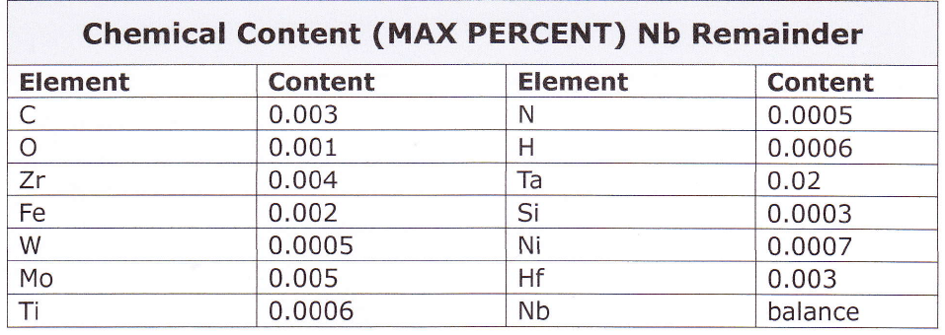
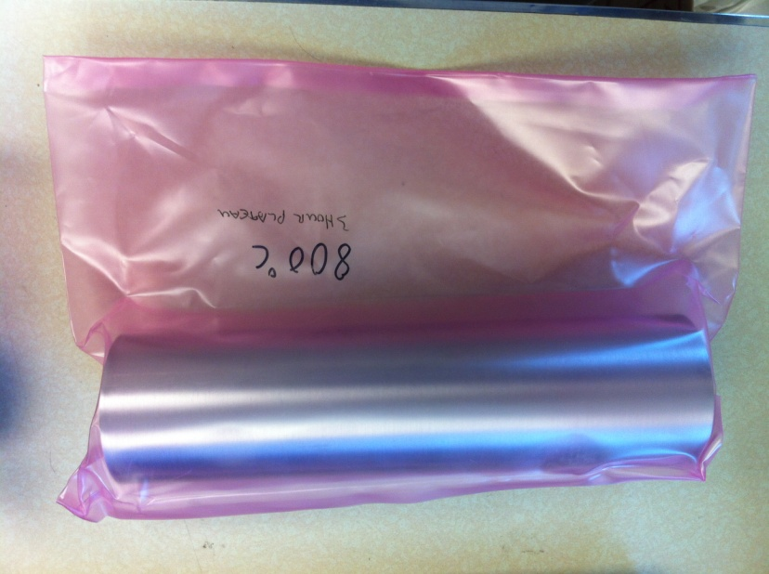
Specification_Nb
Manufacturer: Fire metal Co., Ltd.
Dimension:
- OD: 63.5 mm, Wall thickness: 1.65 mm, Length: 240 mm
3) Chemical properties
4) Heat treatment: 800 °C for 2 hrs and 1000 °C for 3 hrs
(Supported by Fermilab)

Slide 17
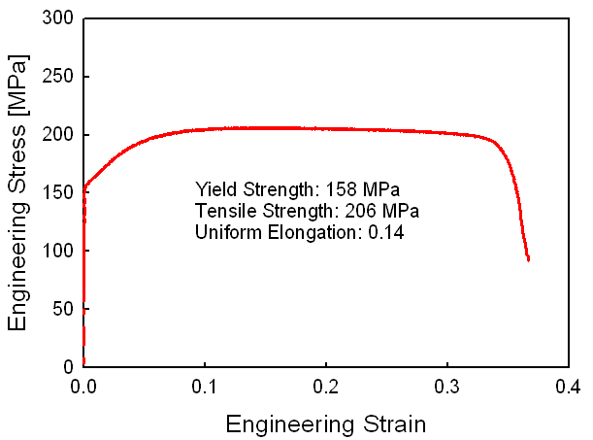
Tensile test results_Nb
As received sample (strain rate = 0.001/s)
Constitutive equation
 | K (MPa) | n
Tensile test | 303 | 0.127
Hollomon format

Slide 18
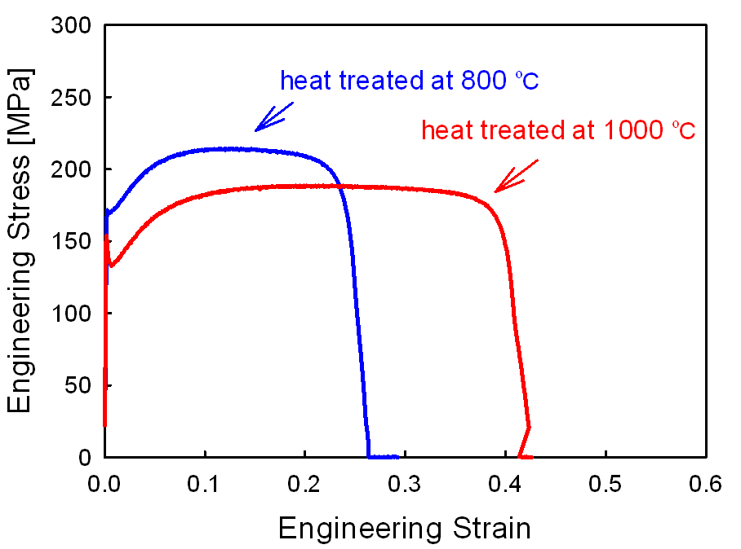
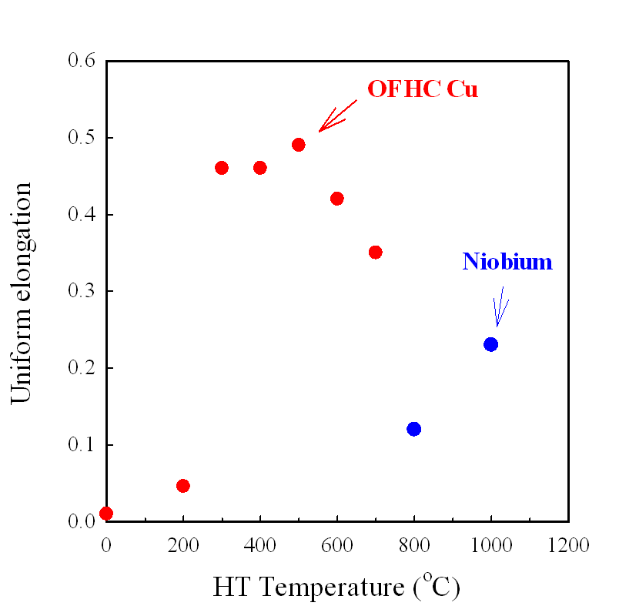
Tensile test results_Nb
Heat treated sample (strain rate = 0.005/s)
Temperature [°C] | Yield Strength [MPa] | Tensile Strength [MPa] | Uniform Elongation | K (MPa) | n
800 | 171 | 214 | 0.12 | 332 | 0.145
1000 | 140 | 189 | 0.23 | 314 | 0.191

Slide 19
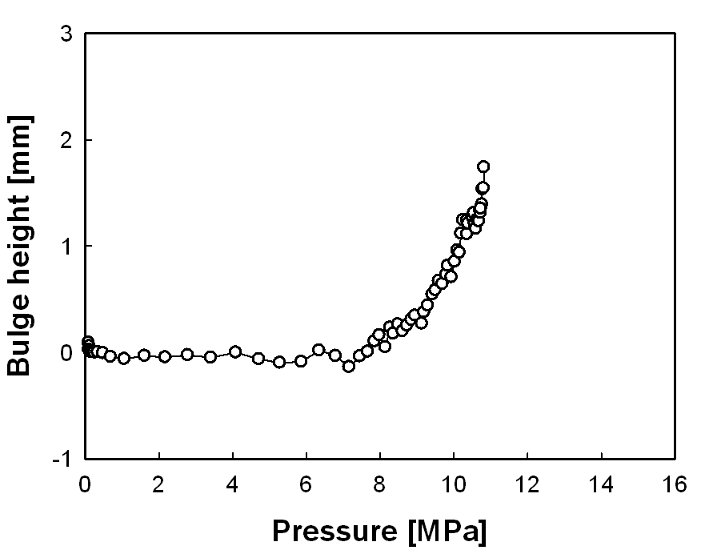
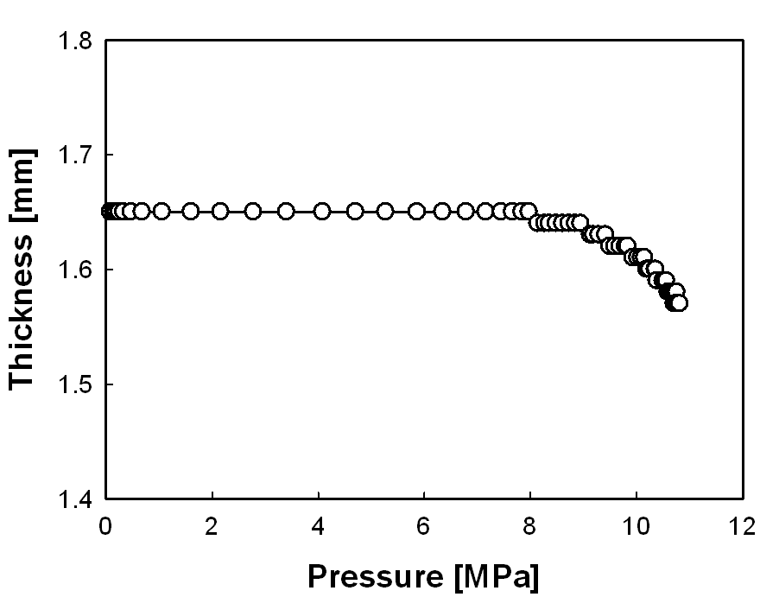
Bulge test results_Nb_(1)
Nb Tube: Heat treated at 1000 °C for 2 hrs
Burge test is limited by the occurrence of failure.
It is necessary to increase the formability by changing the heat treatment.

Slide 20
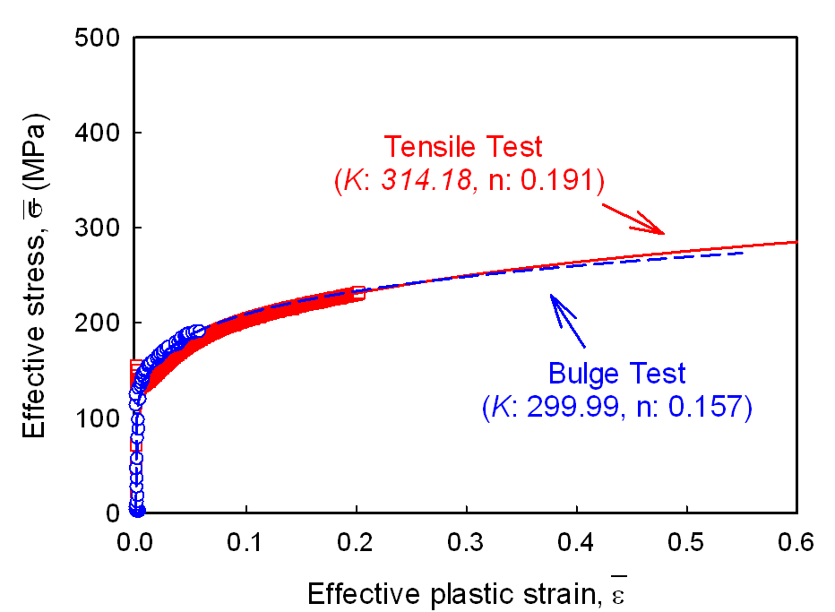
Bulge test results_Nb_(2)
Analytical model
Bulge test results
Effective Stress – plastic strain curve
Constitutive equation
Hollomon format
Use these plastic constitutive equations as a input for simulation

Slide 21
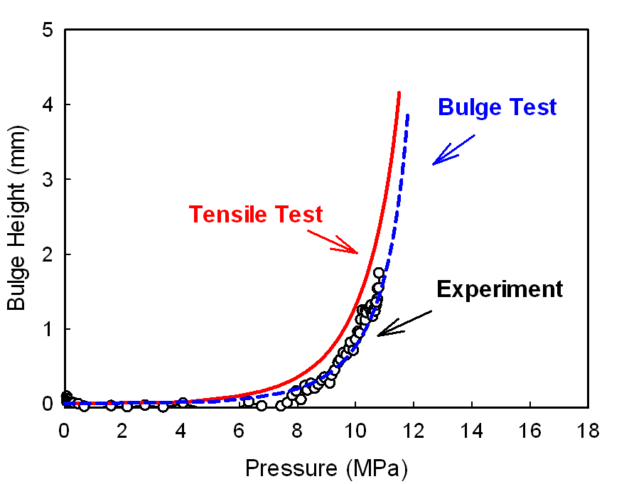
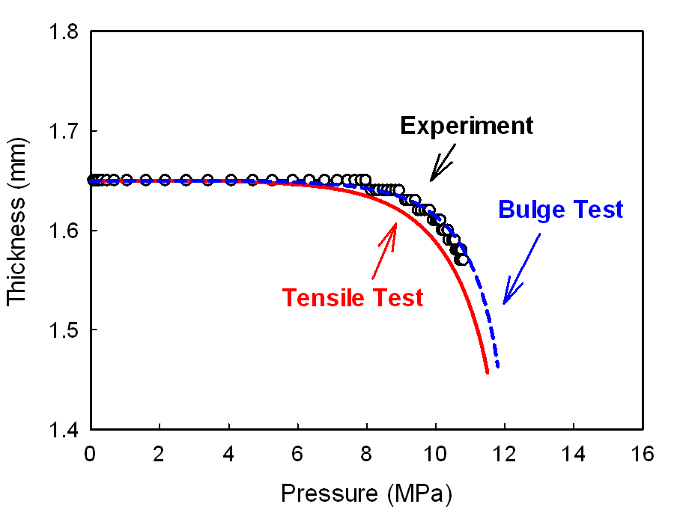
FEA Results_Nb
Combined simulation results using flow stress curves
from tensile test and bulge test
The simulation results using the flow stress curve from bulge test is well matched to the experimental data.

Slide 22
Concluding summary
The OFHC Cu heat treated at 500 °C shows the maximum RRR, rr, and uniform elongation.
The simulation results using the flow stress curve from the bulge test is closer to the experimental data.
The tube bulge test is required to determine the plastic constitutive equation of tubular materials representing more accurate deformation behavior of tube.
For niobium, the different heat treatment is required to increase the formability.
Next Step
Find the optimal heat treatment condition for niobium tube
Construct advanced simulation model

Slide 23
Acknowledgements
This work was funded by the Unites States Department of Energy through Grant No. DE-SC0004217
The heat treatment for Nb tube was supported by the Fermilab

