Slide 1

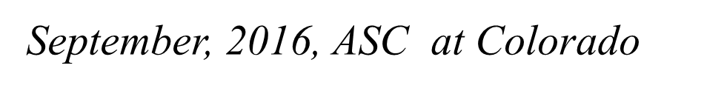
AC Loss Measurements of MgB₂ Strands Designed for Motor and Generator Applications
M.D. Sumption, C. Myers, F. Wan, M. Majoros, E.W. Collings
Center for Superconducting and Magnetic Materials, MSE, The Ohio State University
M.A. Rindfleisch, M.J. Tomsic
Hyper Tech Research
Funded by a NASA SBIR

Slide 2
Outline
AC Loss Analysis and Targets
Reducing hysteretic Loss – conductor development
Reducing Coupling current – conductor development and measurement
Reducing transport Loss—conductor development and measurement
Comparison of progress to goals – and next steps

Slide 3
Targets
MgB2 strand for stator
Bmax = 0.4-0.6 T
F = 200-333 Hz
T = 25 K
Loss < 5 W/cm3 total, maximum

Slide 4
AC Loss components
Field Induced
Hysteretic
Ferromagnetic Substrate
Normal Metal Eddy Currents
Coupling Eddy Currents
Current Induced (Self Field Losses)
Interactions between AC field and AC
Current Effects

Slide 5
Loss Predictions

Slide 6
HTR-MgB₂ Low Loss Wire Types
Push to
Reduce filament size to 20 μm (reduce hysteretic loss)
Reduce Twist pitch (reduce coupling loss)
Reduce wire OD for normal metal and coupling loss
Do both with resistive matrix (reduce coupling loss)
Reduce magnetic content of wire
3647- is a higher filament count , low d_{eff} , some Cu matrix, some magnetic content
3598- even higher filament count, low deff, some Cu matrix, reduced magnetic content
3606 – high filament count, low d_{eff}, all resistive matrix
3630-low d_{eff}, all resistive matrix, further reduced magnetic content
3694—low d_{eff}, all resistive matrix, lowest magnetic content

Slide 7
High filament Count, low AC loss conductors -I
Monel
CuproNi-30
CuproNi-10
Cu
Cu
3467 is a higher filament count , low deff , some Cu matrix, some magnetic content
3598 even higher filament count, low deff, some Cu matrix, reduced magnetic content

Slide 8
High filament Count, low AC loss conductors II
CuproNi-30
CuproNi-10
CuproNi-10
brass
3606-- high filament count, low deff, all resistive matrix
3630 --low deff, all resistive matrix, further reduced magnetic content

Slide 9
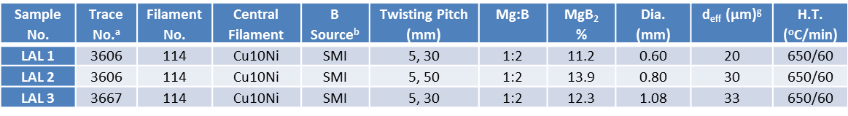
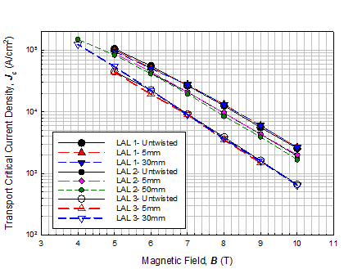
High filament Count, low AC loss conductors II
brass
Cu-10Ni
CuproNi-10
F Wan 3MPo2C-09
3694 --low deff, all resistive matrix, lowest magnetic content

Slide 10
Measurements
Hysteretic loss
Coupling loss
Transport loss

Slide 11
Hysteretic Loss Component
T = 25 K
(NASA Temperature of interest)
Bmax = +- 3 T
Short sample, L = 5 mm
Untwisted
Wire 3467, with Monel outer can, has significant magnetic response
While hysteretic loss from the ferromagnetic component is low, modifies transport loss

Slide 12
Hysteretic loss summary and projections for NASA stator conditions

Slide 13
Coupling Loss component

Slide 14
Coupling loss analysis
ρ(Cu-10 Ni) = 16.7 μΩcm
ρ(Cu-30 Ni) = 36.5 μΩcm
BUT, in general for MF composites,
ρ=ρ_{B}(1-λ)/(1+λ) if fil/matrix interface is clean
ρ=ρ_{B}(1+λ)/(1-λ) if fil/matrix interface is dirty
If λ =0.5, and the interfaces are dirty, then ρ = 50 and 90μΩ cm, for 10 an 30 Ni
If λ =0.5, and the interfaces are clean, then ρ = 5 and 11μΩ cm, for 10 an 30 Ni
While the MgB2/Nb interface is dirty, the Nb/Cu interface is clean – and since ρNb << ρCuNi, the Nb acts like a SC even at 20 K for determining the λ factor

Slide 15
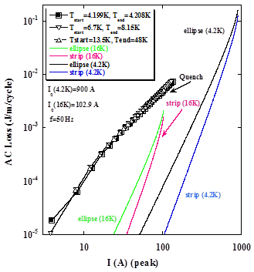
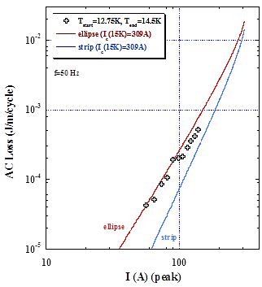
Transport loss Monel “standard” and Glidcop strand
At I/Ic = 0.5, Ferro mag factor = 10 For high mag strand

Slide 16
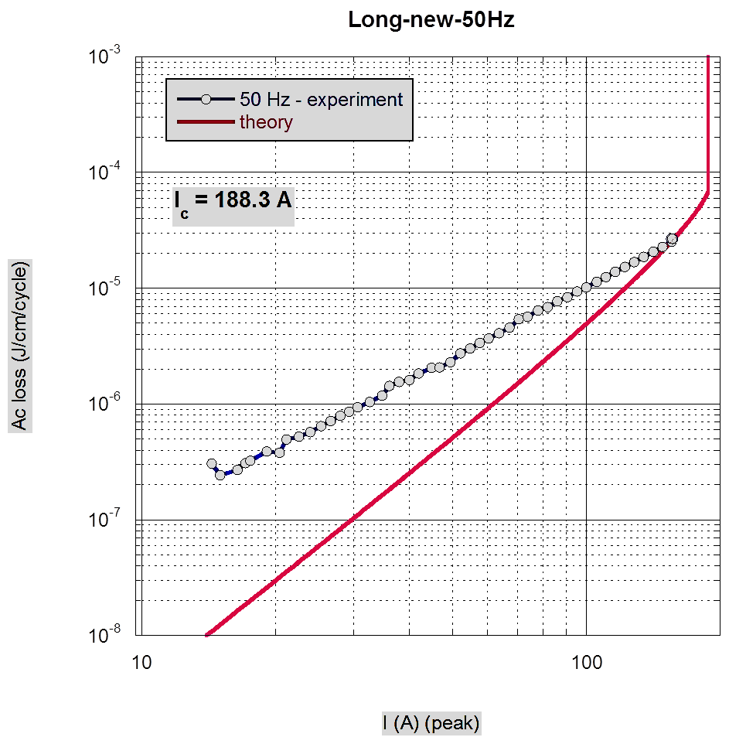
Transport loss in strands with magnetic content
3633
54 filaments
1 mm OD
Brass Outer Can
Matrix Cupro-10 Ni
Deviations rom Norris loss expressions due to magnetic materials in strands
Loss is not ferromagnetic loss, but due to increase in local field intensity in MF zone
At I/Ic = 0.5, Ferro mag factor = 3
For lower mag strand
T = 25.5+-1.5 K

Slide 17
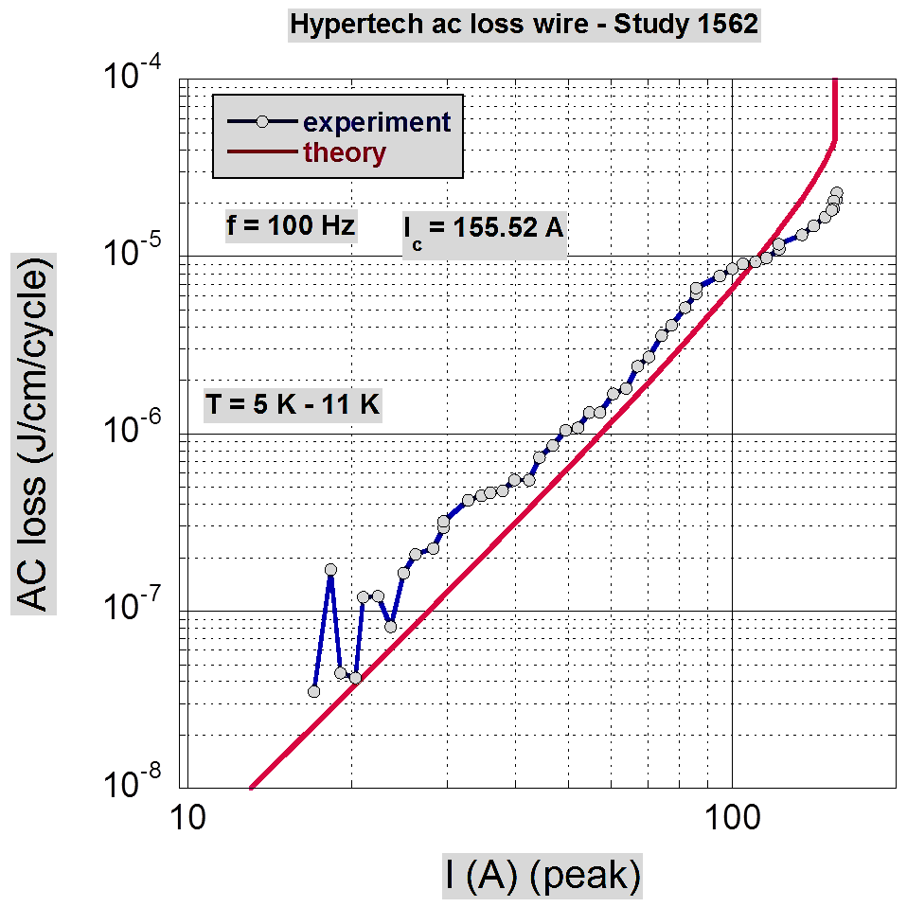
Transport Loss for strand with no magnetic content
Strand 3552
54 filaments
OD = 0.5 mm
No magnetic materials
Brass outer
Brass matrix
T = 8+-3 K
Good agreement with Norris cubic loss expression

Slide 18
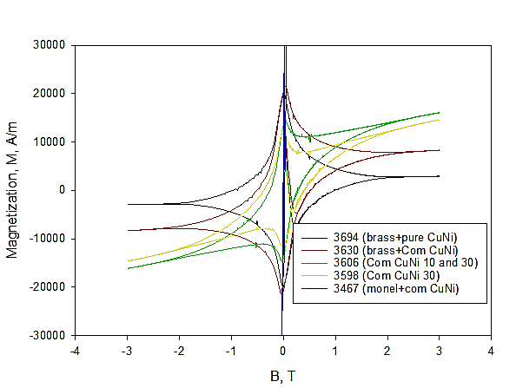
Efforts to Reduce excess ferro-induced transport Loss
Reducing magnetic content

Slide 19
Summary Data Result

Slide 20
Summary
MgB2 low loss strands are of interest for NASA stator applications at 25 K, B = 0.4-0.6 T, and f = 200-333 Hz
Loss Estimates have been made for hysteretic, coupling, and transport loss components, as well as their addition
Advanced, low loss MgB2 strands with deff = 20 μm, resistive matrices, small wire OD, and low magnetic content have been developed
Hysteretic, coupling (at lower f, larger Lp), and transport losses have been measured for a variety of strand designs
Loss values are approaching and reaching initial target values
Further work is needed to push these loss values lower, to make cooling and stator design easier

