Slide 1
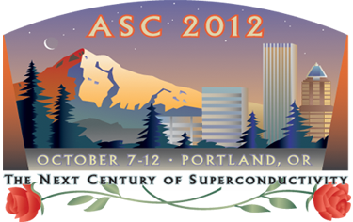


Contact Resistance, Current Sharing, Coupling Currents, and Magnetization for Coated Conductor Roebel Cables and CORC cables for HEP Applications
2JF-01
M.D. Sumption, M. Majoros, E.W. Collings
Center for Superconducting and Magnetic Materials, MSE, The Ohio State University
Nick Long, IRL, New Zealand
Applied Superconductivity Conference, Portland Oregon, Oct, 2012
W. Goldacker
D Van Der Laan, Advanced Conductors
A. Nijhuis, E Kershoop, The University of Twente, EMS Group
This work was funded by the U.S. Dept. of Energy, Division of High Energy Physics, under Grant No. Grant No. DE-FG02-95ER40900 (University Program)

Slide 2
YBCO Roebel in HEP Context
It is useful to consider YBCO for HEP magnets for very high field devices, like 50 T solenoids for muon colliders, because they are enabling. Worth considering for other HEP magnets (very high field dipoles) as well
Large magnets need cables, typically tens of kAs
Cables need current sharing between the strands for stability and protection reasons in LTS, as well as current distribution uniformity considerations
Strand to strand contacts must be low resistance enough to allow this, but high enough to keep low loss
These same considerations needed for Rutherford cables will need to be applied to Roebels, and it is easy to see why since …….

Slide 3
The Roebel is a topological transformation of a Rutherford Cable
i.e., no cutting or pasting operations allowed
Operation 2 flatten
This fact is known, if underappreciated, so what?
the loss current paths, the losses of which have been calculated for Rutherford, transform topologically as well
Some concepts from Rutherford are transferrable
Operation 1 rotate
Operation 3 flatten some more

Slide 4
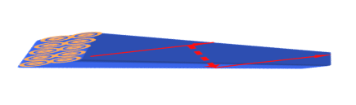
Topological equivalence of coupling current paths in Roebel and Rutherford cables
FO Coupling loop, involves R⊥
R⊥, this is a connection between “top”and “bottom” layer strands
In the Roebel cable this would mean left and right side connections, and these don’t exist
dB/dt
dB/dt
EO Loop, R//
Old EO Loop Transformed, would imply strand 1 having continuous contact with strand 2, and 2 with 3, and 3 with 4 etc, all on the strand faces. In fact this is true, but the R involved can be high

Slide 5
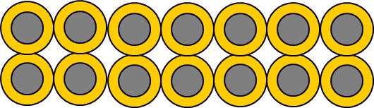
Use of Rutherford Expressions for Roebel
For Rutherford cables the AC Loss expressions for coupling loss per cycle per m³ are
EO
FO
EO
FO
Realizing that Rc is infinite, then both field applied to the face and field applied to the edge of the Roebel cable will follow
With different proportionality constants in front for cable face and cable edge orientations and Ra refers to nearest strand contact, e.g., 1-2, 2-3, etc

Slide 6
Attempt to Create Current Sharing in YBCO Roebel Cables--Similarity in Problems, similarity in solutions
As-received Roebel cables have no coupling --This means no eddy current magnetization, but also no current sharing
For Rutherford cables, typically ICR is controlled by the oxide layer on the strand surface (or core surface) – this is also true for YBCO
For Rutherford cables this can be manipulated by low T sintering to break down the surface oxide, we could try that (did not work so well, see below) – METHOD 1
A second ICR modification method in Rutherford cables was the use of a deformable Ag-Sn solder, which also replaced the heavy Cu oxide with a lighter one –this is our motivation for using a Sn sheet for contacts in Roebel below – METHOD 2
In some cases, contacts in Rutherford cables were soldered, we also tried this – METHOD 3
We used AC loss and direct I-V to determine the ICR, and asses the results

Slide 7
Direct Contact Method for ICR
We can adopt the direct I-V technique used by Arian Verweij in his measurement of ICR in Rutherford cables, see “Electrodynamics of Superconducting cables in Accelerator Magnets, Thesis, University of Twente 1995
Rmax
R// only
Rc as well
Another way to see this is that we have N resistors in parallel, and N/2 series segments of these
Our case corresponds to his Eq 4.46 b, except that the Ra used there is slightly different, and given that our cable length is equal to Lp, we get
Ra = 2Rmax

Slide 8
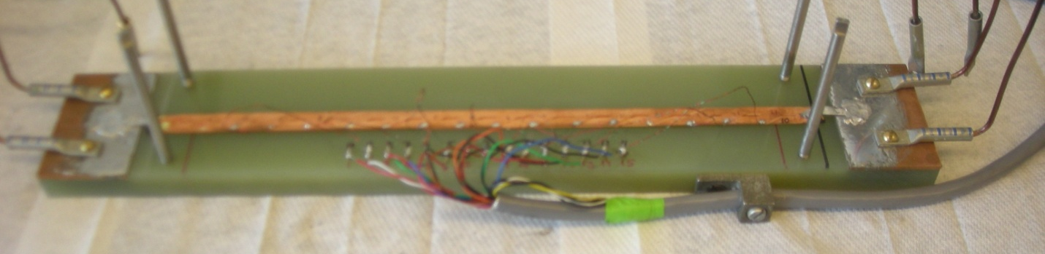
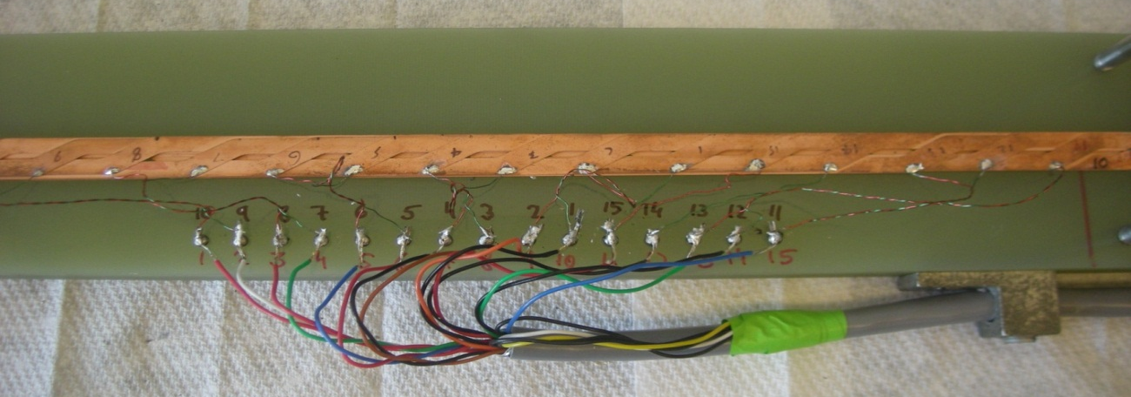
Wiring of the cable
Number of tapes: 15
Current contact on one end of the cable – tape no. 2
Current contact on the other end of the cable – tape no. 10
DC power supply: HP6634 A (1 A – 100 V)
Voltmeter: Keithley 2182A nanovoltmeter
Pairs of the potential taps used for voltage measurements: 1-2, 1-3, 1-4, …. 1-15
Cable Provided by Industrial Research Limited, IRL

Slide 9
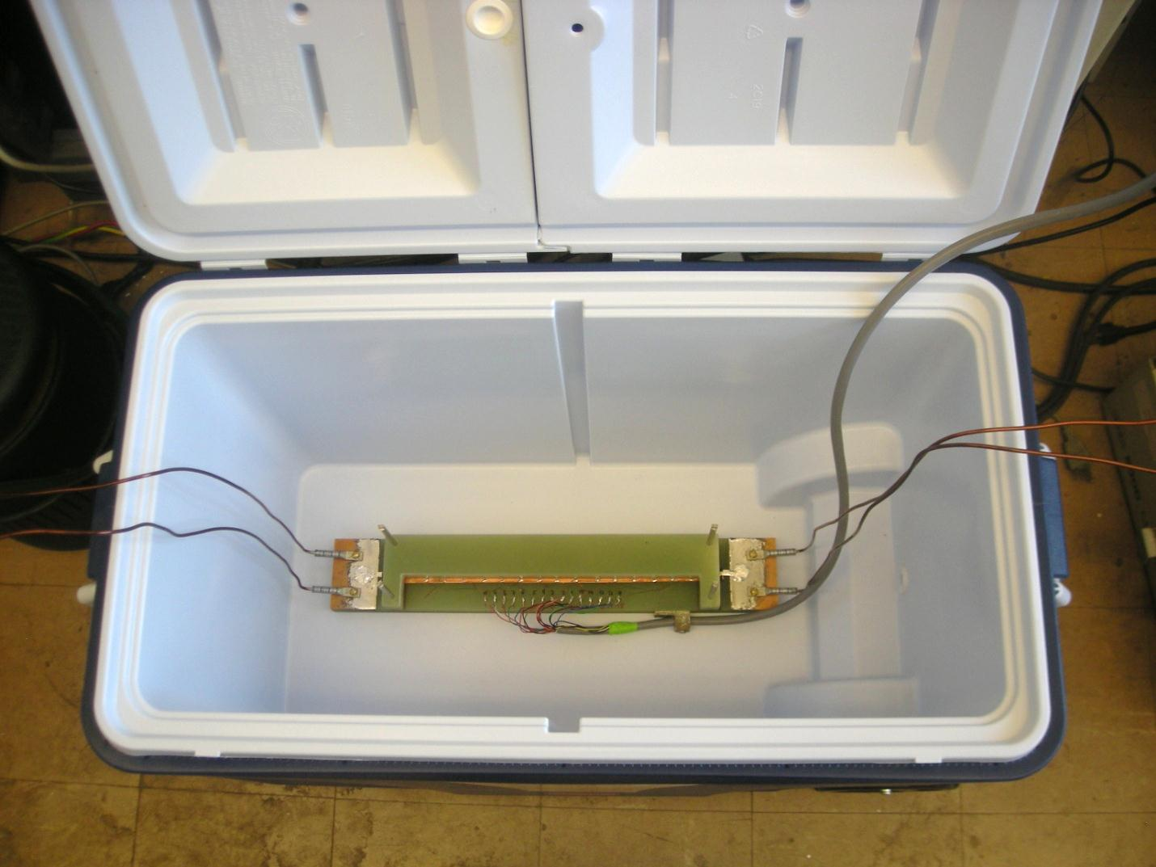
Pressure application
Pressure was applied by adding stainless steel plates on top of the G-10 top plate, both were free to move up and down but stabilized laterally by guide rods

Slide 10
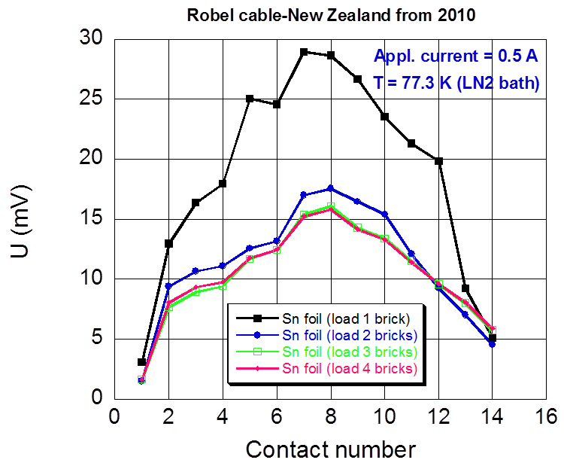
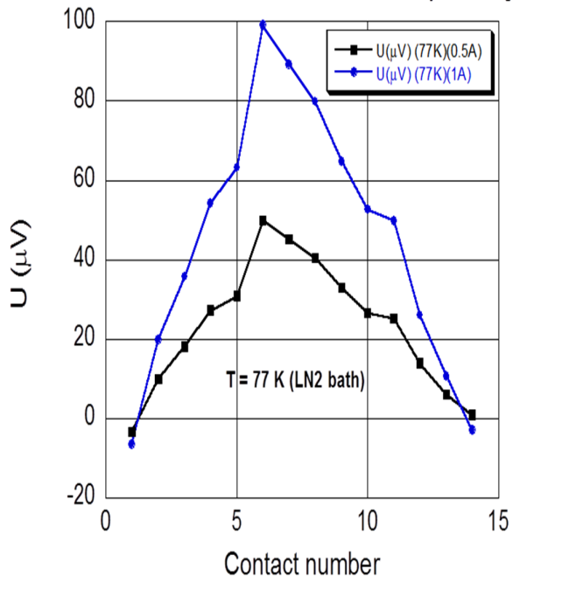
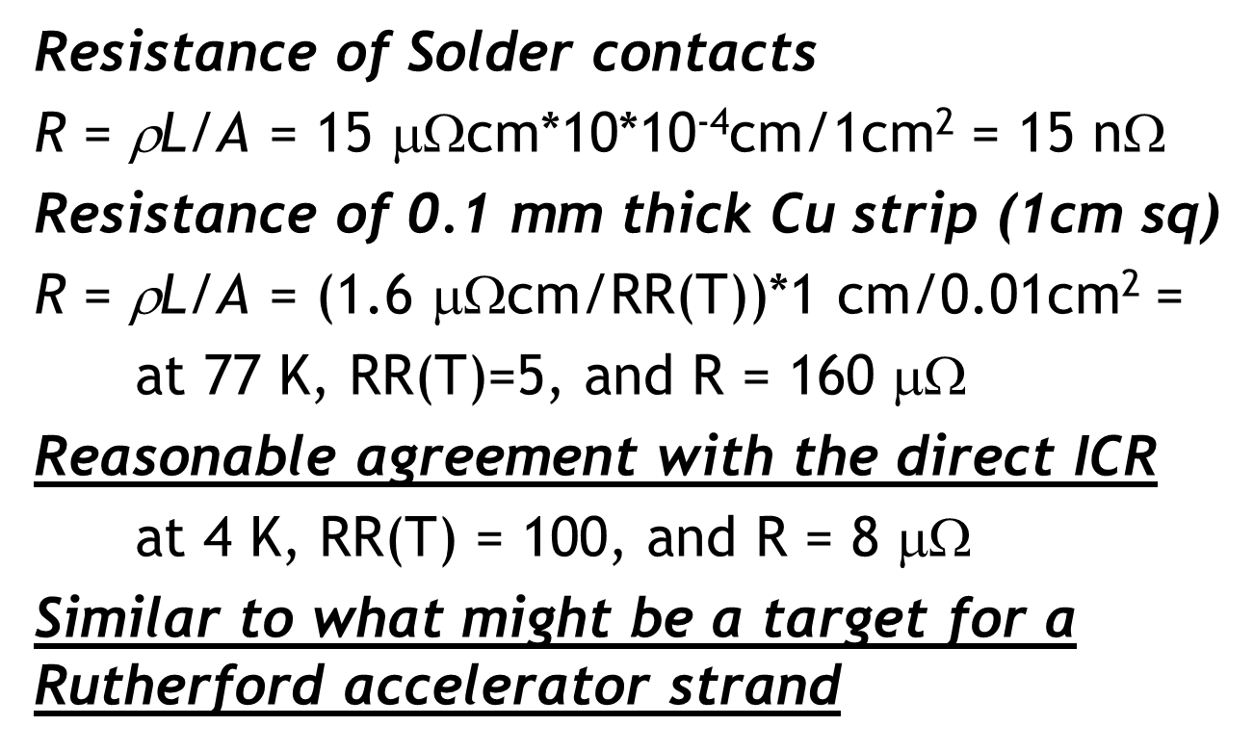
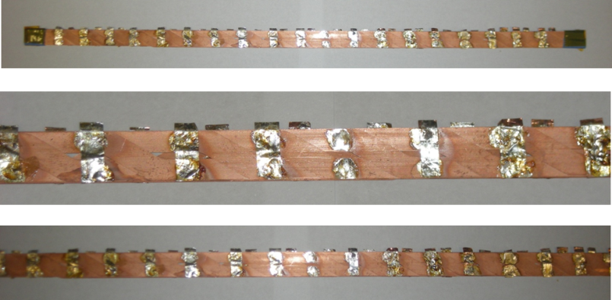
Direct I-V ICR Results
METHOD 2 (soft Metal)
METHOD 3 (Solder)

Slide 11


4.2 K NbTi Rutherford cables, FO
M.D. Sumption,E.W. Collings,, R.M. Scanlan, S.W. Kin, M. Wake, T. Shintomi, A. Nijhuis, and H.H.J. Ten Kate, Cryogenics 41, 2001, 733

Slide 12

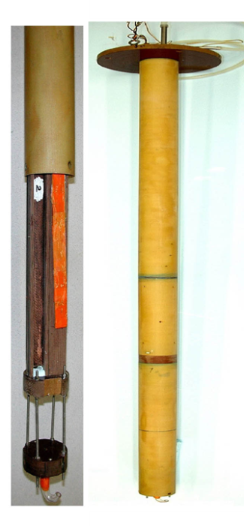
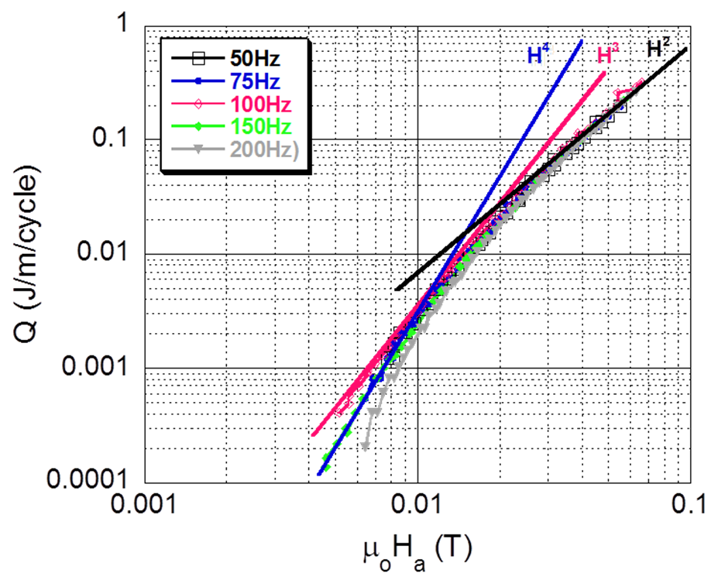
AC Loss Results ∝ magnetization
4.2 K, Rc ≈ 10 μΩ
METHOD 1 – HT Sintering
METHOD 3 – soldering
No apparent increase in loss!
ICR would appear not to have changed!
A similar 4 K contact resistance in NbTi of Nb3Sn based Rutherford cables leads to a noticeable coupling AC loss/magnetization – why not here?
77 K, Rc = 100 μΩ
METHOD 3 – soldering

Slide 13
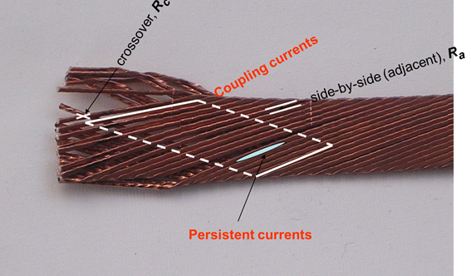
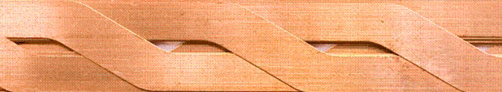
Calculating the Loss slope II
= -dφ/dt = AdB/dt, and dB/dt max is ≈ 0.1 Hz*4*.4T=0.16 T/s
NbTi Rutherford cable
A ≈ Lay pitch*cable width/2=50*15=0.0375 m²
I=ε/R=(6*6⁻³V)/(2*10*10⁻⁶Ω)= 300 A, factor of
5 or so less than NbTi I_{c} at measurement,
strands are partially coupled
YBCO Roebel
A ≈ Lay pitch*slit width=1 cm * 1 mm = 1 * 10⁻⁵ m²
ε≈0.15 * 10⁻⁵ V, I = 0.15 A
Since I_{c} for YBCO is roughly 2000 A at 4 K and low fields, a cross current I of 0.15 leads to essentially no coupling So – The hysteretic losses dominate
THESE ARE EDGE LOOPS SO THE AREA IS MINIMAL

Slide 14

Coupling Schematic in Bean Terms
For this to be true the current flowing from strand to strand must be a relatively high percentage of the strand current, or they will flow in circles in the strands
A cable has coupled strands when most of their I_{c} is taken up in coupling, rather than hysteretic shielding, currents
Green regions are strands
Black lines are flux profiles
Dashed line is flux in coupled state
Blue lines are uncoupled (hysteretic shielding) current
Red lines are coupled current
dB/dt

Slide 15
CORC Cable for AC Loss Measurement

Slide 16
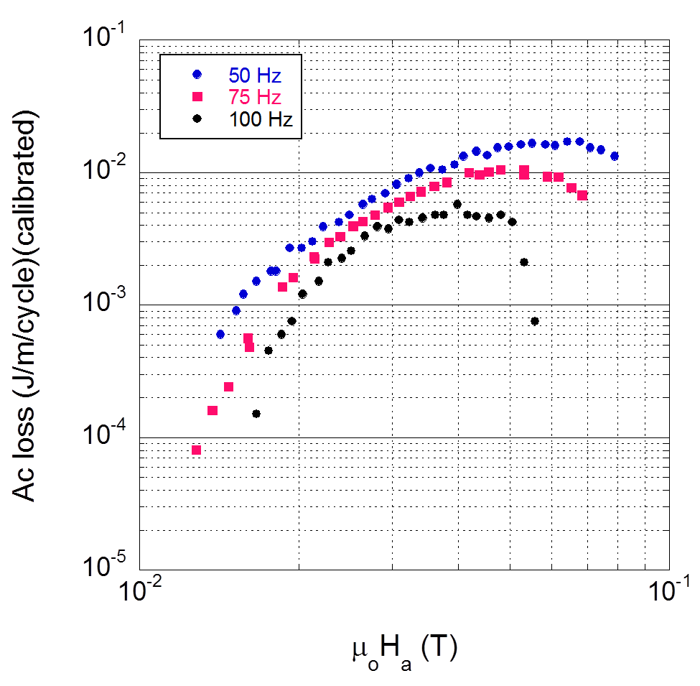
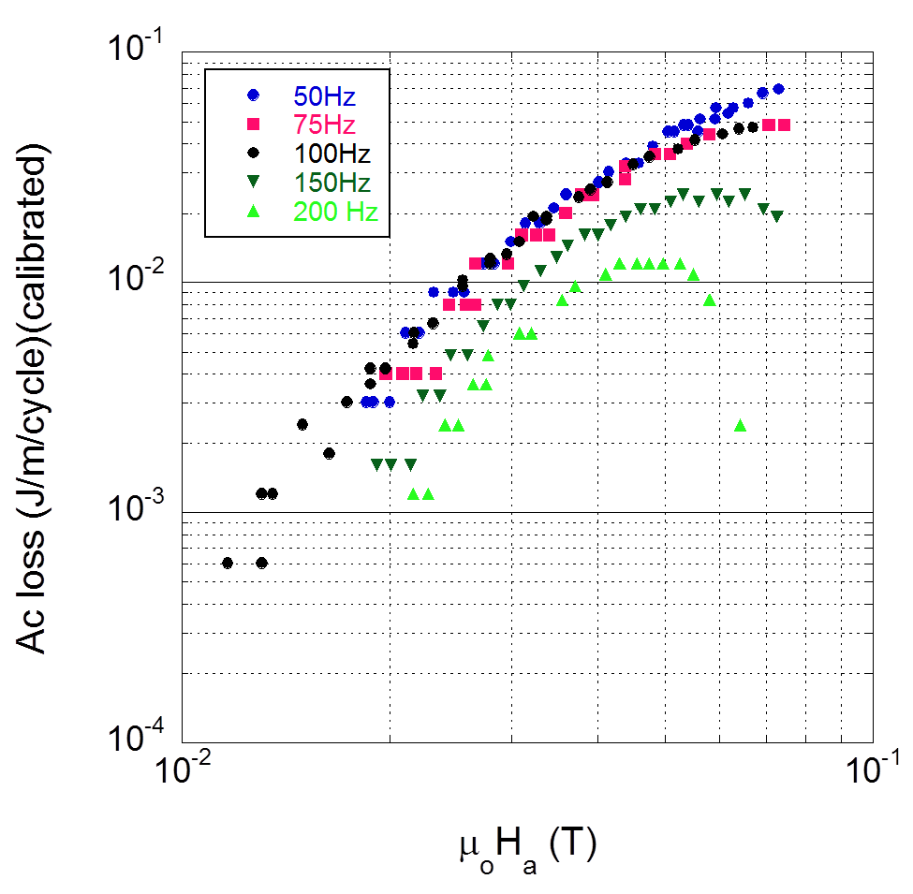
Loss per meter of cable per cycle CORC cable
1 layer, 3 tapes
2 layer, 6 tapes

Slide 17
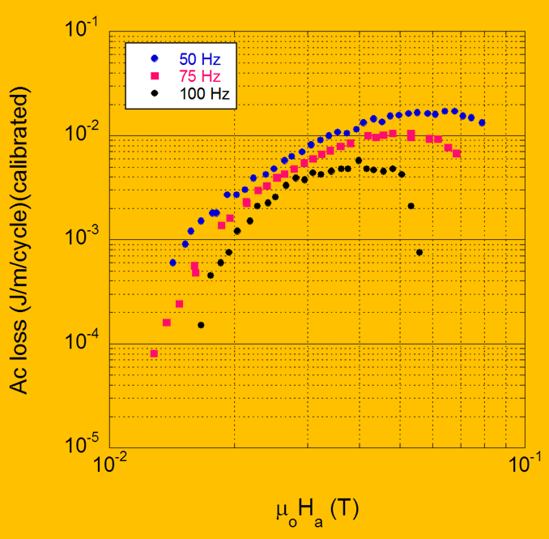
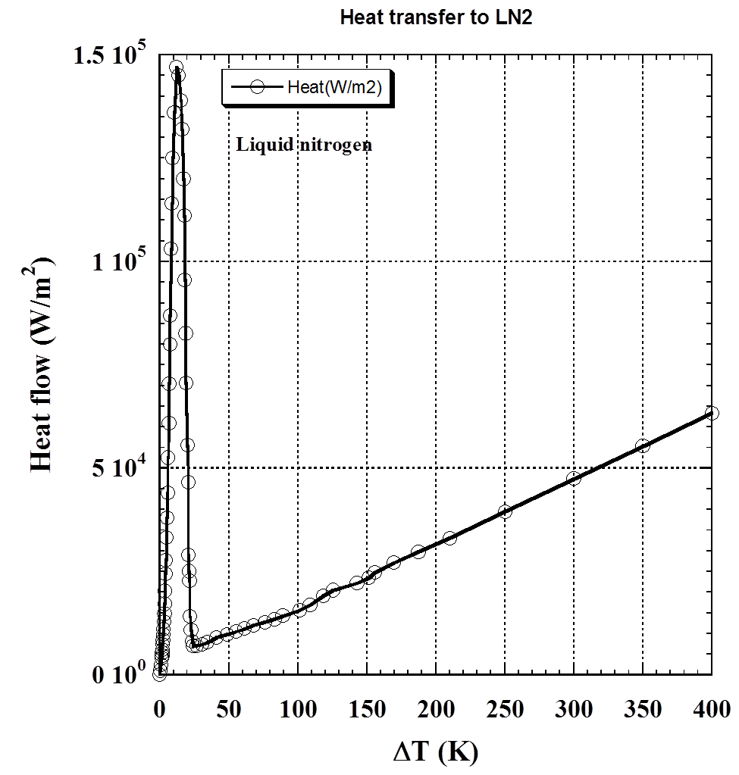
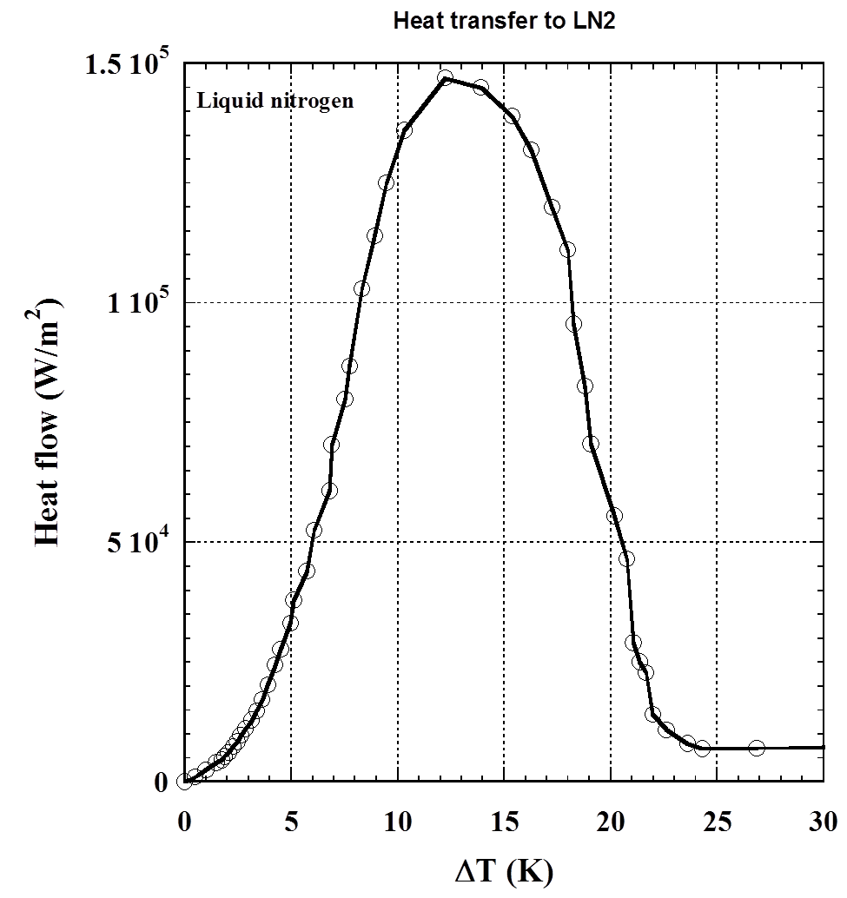
P=[.003J/m/cycle/(.2*.025*.025*3.14)]*100≈8000 W/m2

Slide 18
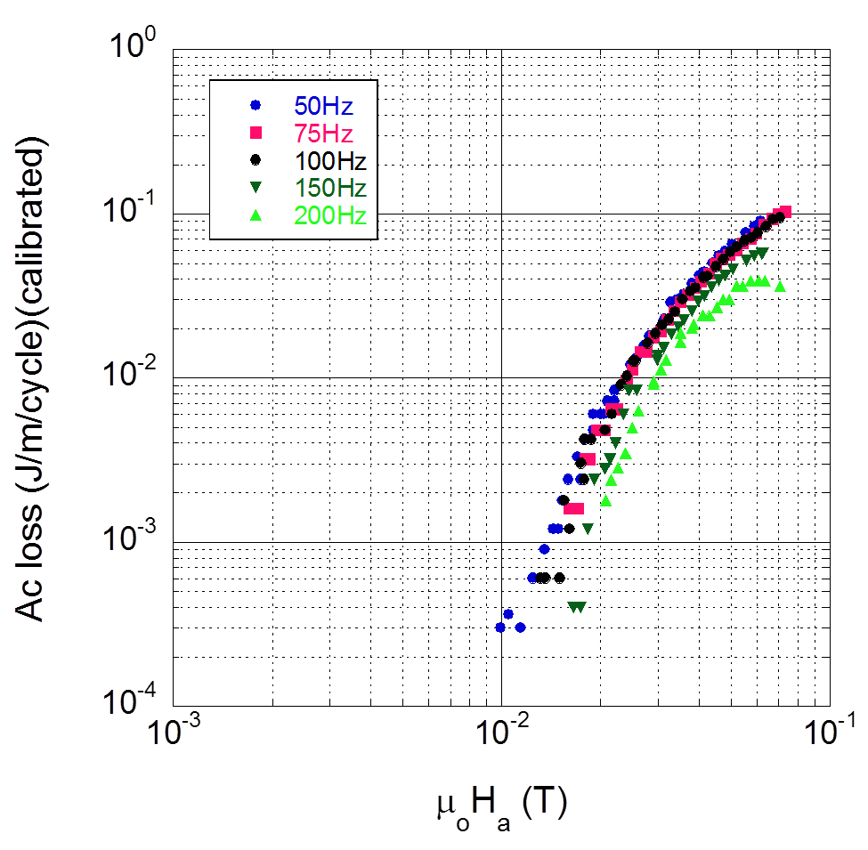
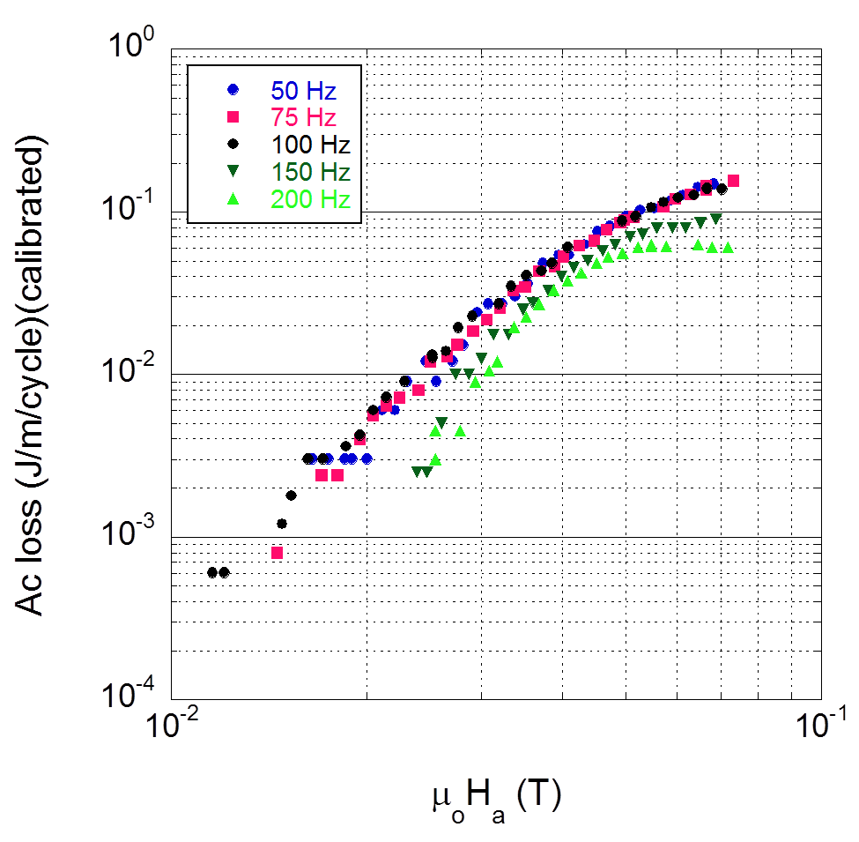
Loss per meter of cable per cycle CORC cable II
3 layer, 9 tapes
4 layer, 12 tapes

Slide 19
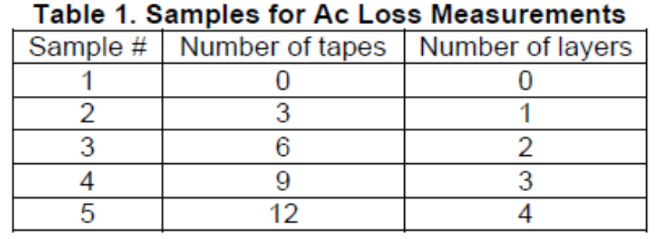
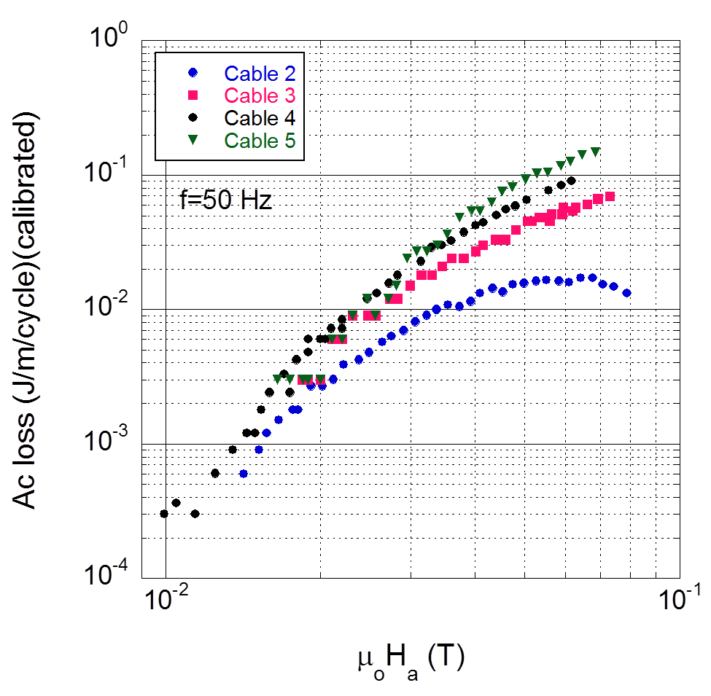
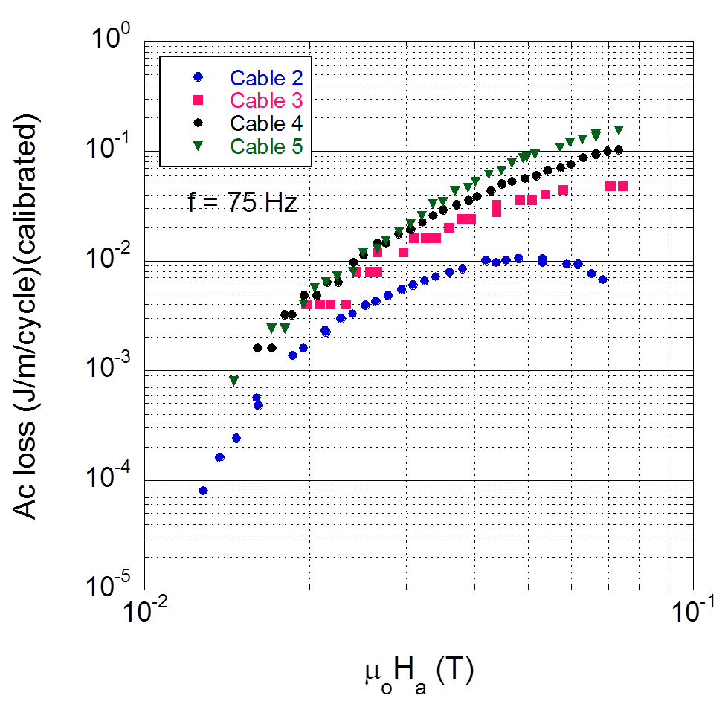
Loss per meter of cable per cycle CORC cable III

Slide 20
Summary-and Questions
Roebel cables are topological transformation of Rutherford cables, current loops are directly transferrable from Rutherford after transforming FO and EO and setting R⊥ to infinity
Pressure and pressure with soft metal reduce ICR, but do not give great contact. Soldering reduces ICR, but does not induce much loss because flux coupling area is small
How Much Current Sharing is needed, given the greater stability of YBCO, and the different protection landscape?
Specifically – what does ICR need to be, and how many nearest neighbors should current share
Are methods that do not “fix” the windings realistic?
CORC Cable losses show interesting results, need further study

